Slide 1

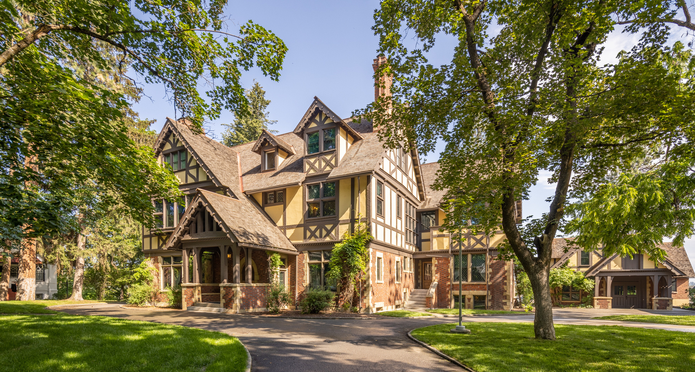




Photo credit:
Dean Davis
Campbell House Digital Tour
1898-1924
MAC Packs are Sponsored by

Slide 2
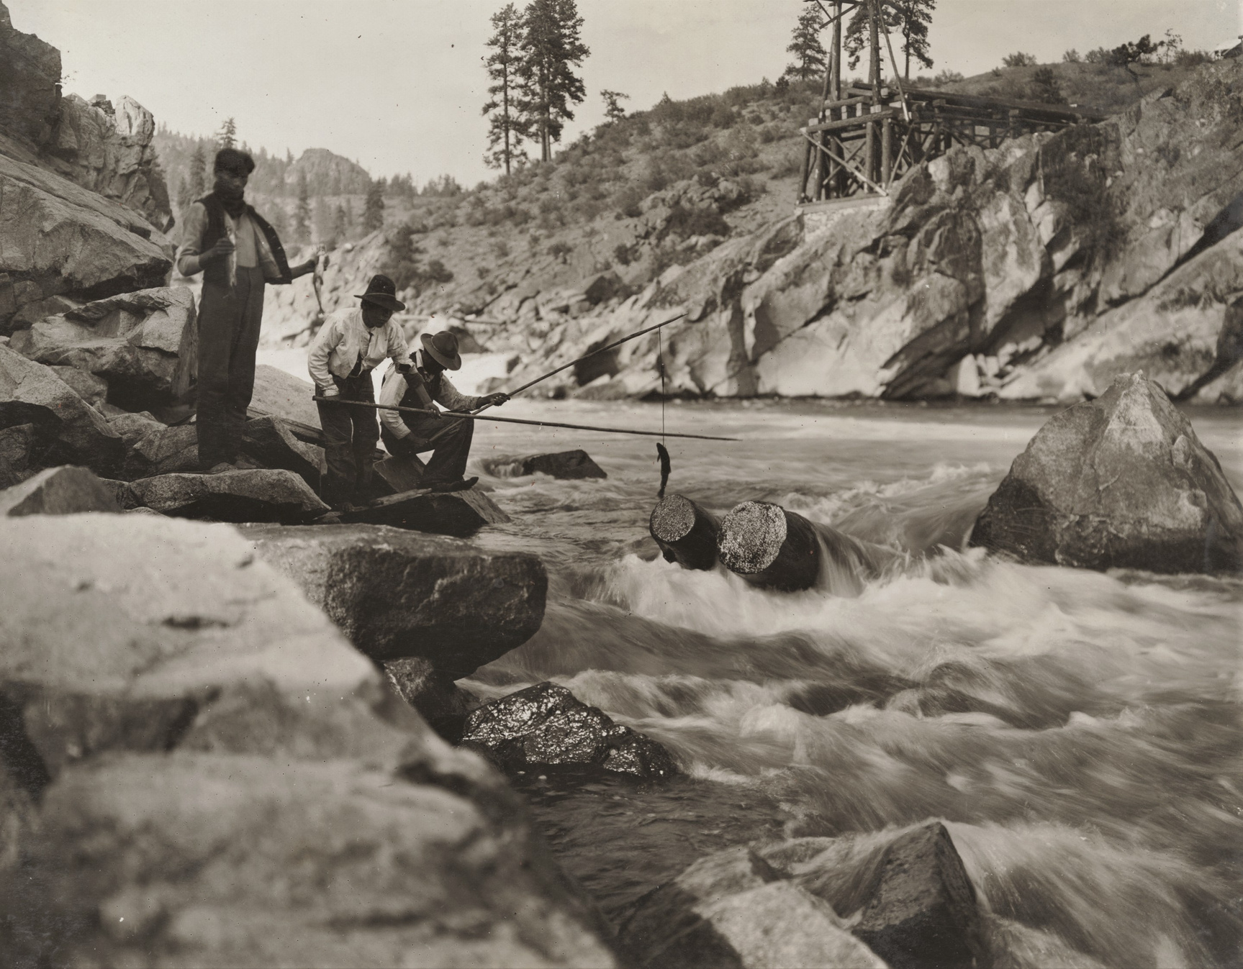
Since Time Immemorial
The Northwest Museum of Arts and Culture and Campbell House sit on the ancestral lands of the spoqin sqelixʷ (Spokane) people.
Ancestors of the Spokane Tribe of Indians have always been here and lived in family groups along the Spokane River between Lake Coeur d’Alene and Little Falls.
The Spokane River and its falls are the heart of the region’s landscape for the people who live here; and have been since time immemorial. For generations, people have used the falls not only for fishing, but also for ceremonies, celebrations, games, and community gatherings.
Campbell House, the subject of this digital MAC Pack, was built in 1898 and is located on the northwest side of Browne’s Addition overlooking the confluence of the Spokane River and Latah Creek.
Fishing on the Spokane River Little Falls, 1908, The Joel E. Ferris Research Archives, L92-86.5
Notes:
1881 The Northern Pacific railroad comes through Spokane
1900-1910: Boom Town!
1900 Spokane’s population was 36,868. By 1910, Spokane’s population had grown to 104,402 people.

Slide 3
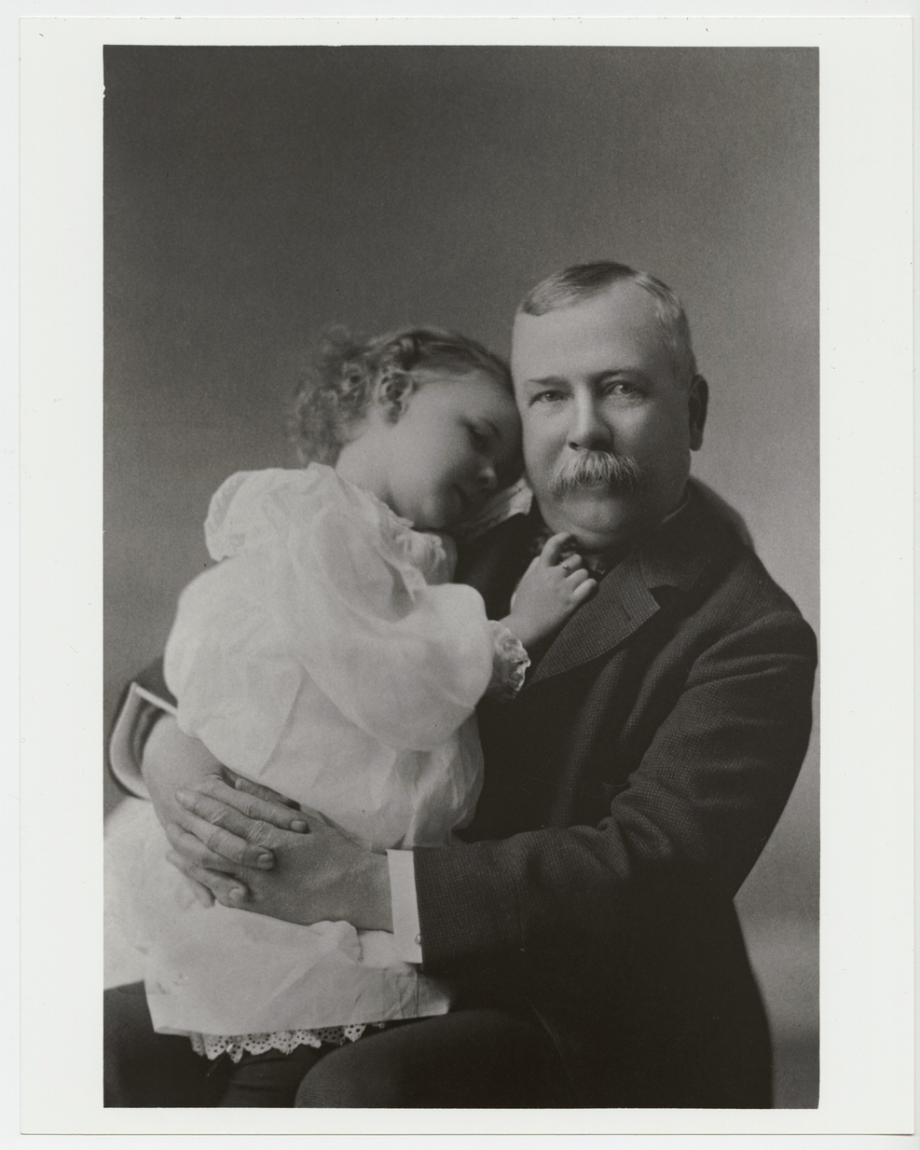
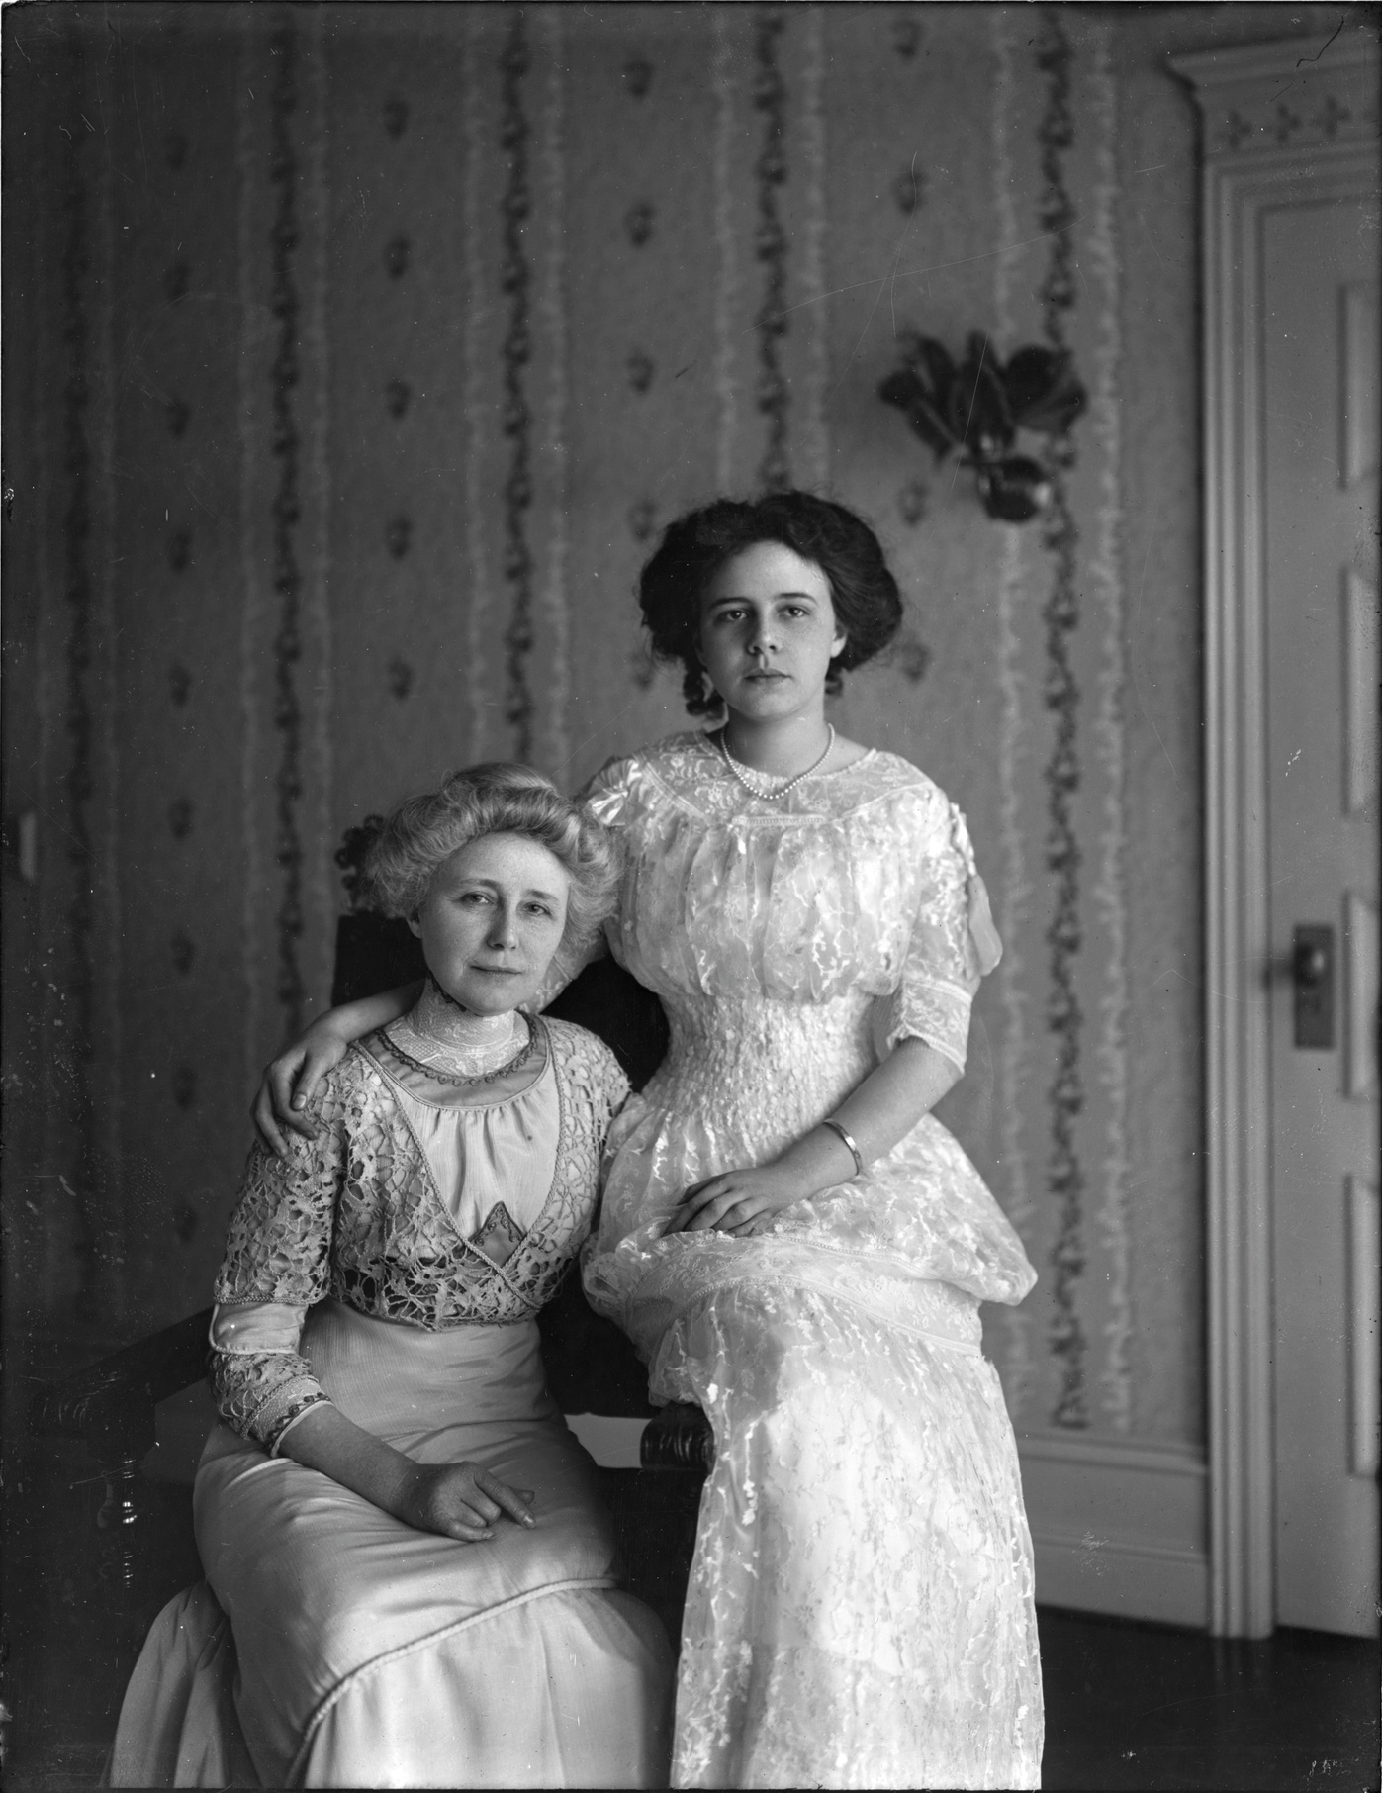
Amasa Campbell arrived in the Coeur d’Alene, Idaho mountains in 1887 looking to make his fortune in the silver mines. He, his business partner, John Finch, and Ohio financers, invested $25,000 in the Gem mine and built a mill to work the ore. They prospered beyond their wildest dreams.
In 1890, With his finances secured, he went back to Ohio to marry Grace Fox and they started their new life in Wallace, Idaho.
Their daughter, Helen, was born in 1892.
In 1898, when Helen was six years old, the family moved to Spokane after the completion of their new home in Browne’s Addition. After her mother’s death, Helen donated her home to the Eastern Washington Historical Society and the Spokane Art Association. It was named the Grace Fox Memorial Museum.
This digital MAC Pack will give you a tour of the Campbell home and introduce you to each family member and several of the servants who lived and worked in Campbell House.
Grace and Helen Campbell, 1908, The Joel E. Ferris Research Archives, Campbell House Collection, L91-119.3
Helen and Amasa Campbell, 1895, The Joel E. Ferris Research Archives, Campbell House Collection, L86-287
Notes:
Amasa (1845-1912) Grace (1859-1924)
Arrived Idaho 1887
Invested $25,000 in the Gem Built a mill to work the ore
1890 Marriage
Helen (1892-1964) born
Move to ID - Union Strikes
Spokane financial & Cultural center of the region
How do we know all of the information we do? Vast primary sources for CH
Take a tour through the house while learning about the family and the servants who worked for them.

Slide 4
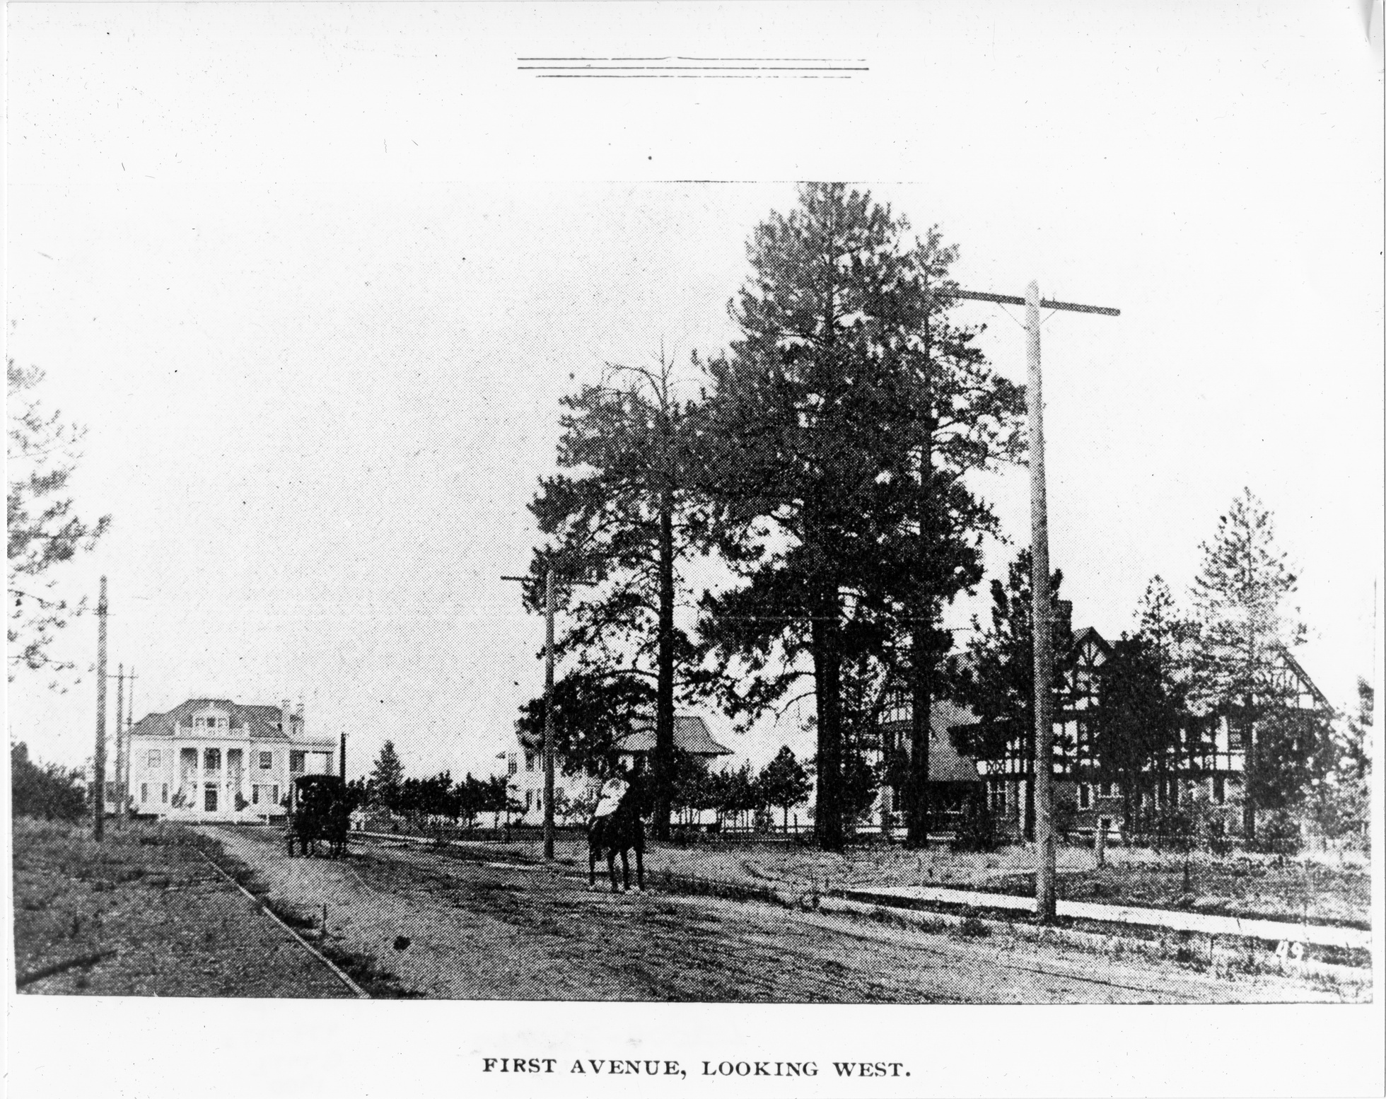
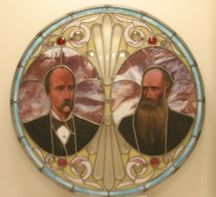
Auditorium Theater stained glass window of JJ Browne (1843-1912) and Anthony Cannon (1839-1895), 1890, NN99.47
Browne’s Addition
Spokane’s Oldest Neighborhood
First Avenue, Campbell, Wakefield, and Finch Homes, 1898, The Joel E. Ferris Research Archives, Campbell House Collection, L2004-32.987
Notes:
J.J. Browne born in Ohio.
1873 moved to Portland, OR
1878 Browne meets Anthony McCue Cannon (born in Illinois in 1837).
They met while travelling up the Columbia River to check out Spokane Falls.
Purchased half of the townsite of Spokane Falls from James Glover for $3000, starting with a $50 downpayment,
Purchase included James Glover’s general store and the adjacent sawmill.
Cannon started Spokane’s first bank, the Bank of Spokane Falls, in the back of the store.
Browne served as Spokane’s first lawyer and its first superintendent of schools
Browne, Cannon and James Glover created Spokane’s first successful newspaper, the Spokane Falls Chronicle.
Browne served as Spokane’s first lawyer and its first superintendent of schools
.
Browne, Cannon and James Glover created Spokane’s first successful newspaper, the Spokane Falls Chronicle.

Slide 5
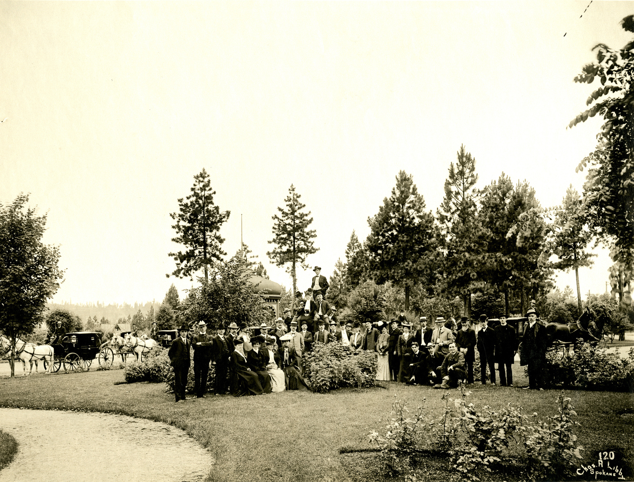
Early founders of the incorporated city of Spokane, James Glover, J.J. Browne, and Anthony Cannon, made a bet that the northern line of the transcontinental railroad would run through a new, small, townsite located along the Spokane River’s cascading falls.
John J. Browne and Anthony Cannon met in 1878 while traveling up the Columbia River, heading to Spokane. After confirming they wanted to invest in the emerging town, Browne and Cannon purchased half of the townsite from James Glover for $3000.00. The purchase included Glover’s general store and the adjacent sawmill.
Cannon started Spokane’s first bank, the Bank of Spokane Falls, in the back of the store. Browne served as Spokane’s first lawyer and its first superintendent of schools. Browne, Cannon, and Glover teamed up to create Spokane’s first successful newspaper, The Spokane Falls Chronicle in 1881.
The three men’s bet paid off; Spokane grew rapidly once the Northern Pacific Railroad’s Seattle to Spokane track was completed in 1881. Two years later, in western Montana, President Ulysses S Grant drove in the golden railroad spike that completed the northern transcontinental railroad system. As Spokane prospered, families like the Campbells began pouring into town. The fashionable neighborhood in which the Campbell family chose to build their home was Browne’s Addition, established by John J. Browne. It was the city’s first neighborhood and stood adjacent to downtown Spokane, close to where Amasa Campbell and John Finch’s business offices were located.
Browne’s Addition Coeur d’Alene Park, 1900-1905, The Joel E. Ferris Research Archives, L87-1.120
Notes:
1881 The Northern Pacific railroad comes through Spokane
1900-1910: Boom Town!
1900 Spokane’s population was 36,868. By 1910, Spokane’s population had grown to 104,402 people.

Slide 6
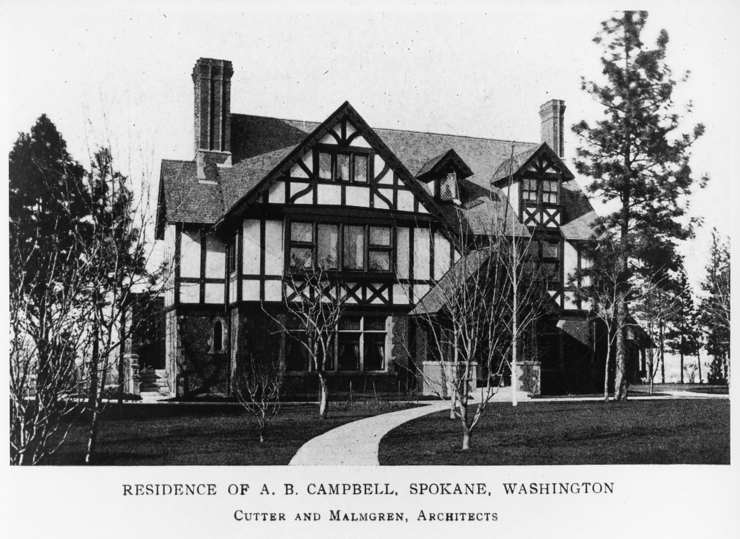
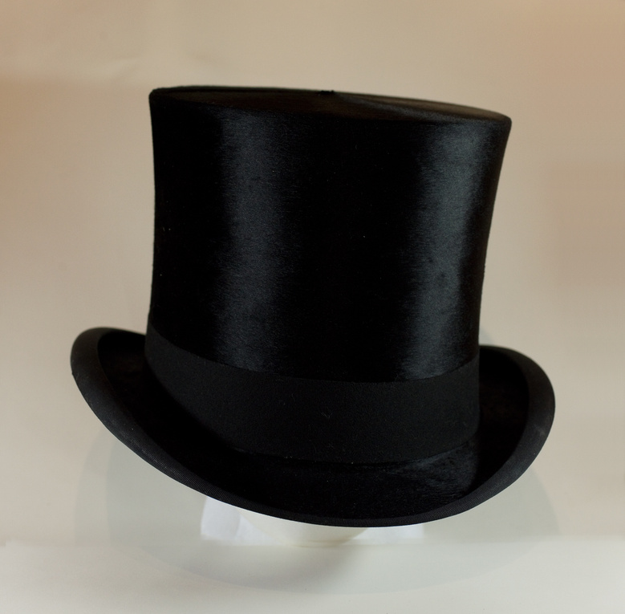
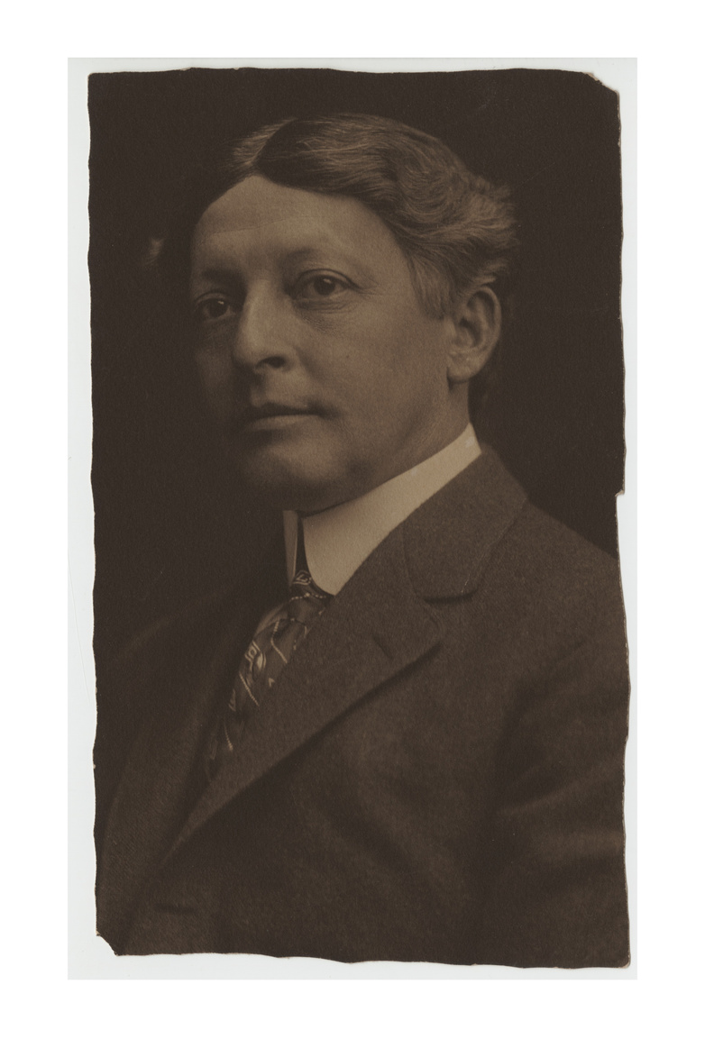
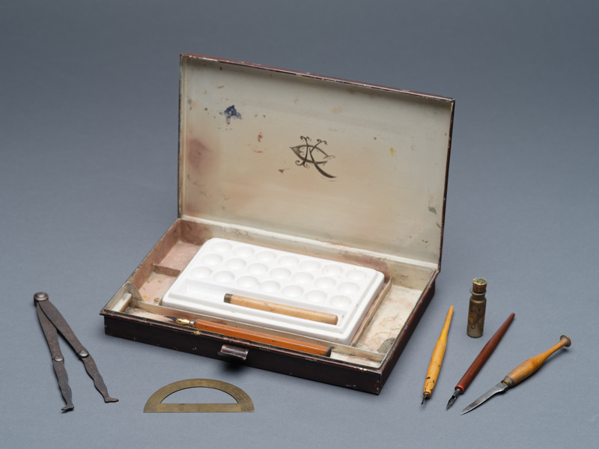
Architect, Kirtland K. Cutter (1860-1939) designed many of Spokane’s prominent homes and public buildings, including Campbell House. Cutter was born in Cleveland, Ohio on August 20, 1860. He attended Brooks Military Academy in 1874 and then the Arts Students League of New York c1878. He left New York to study art in Europe. In 1886, after returning from Europe, Cutter moved to Spokane to work in his uncle’s bank. Spokane’s great fire in 1889, was a catalyst that launched Cutter’s architectural career and his architectural designs can be found throughout the Pacific Northwest. In Browne’s Addition, he designed Campbell House, John Finch House, W.J.C. Wakefield House, and Patsy Clark’s mansions.
Kirtland Cutter’s designs of the 1890s and early 1900s reflected the City Beautiful movement, with its incorporation of European Arts and Craft Revival styles. Campbell House, built in 1898, is an Arts and Crafts English Tudor Revival. Each room reflects a different time period and style theme. The home featured the latest technologies available in 1898, including electricity, a telephone, hot and cold running water, and radiation heat with the boiler located in the cellar.
Campbell House, 1898, The Joel E. Ferris Research Archives, Campbell House Collection, L94-40.35
Northwest Museum of Arts and Culture, 3189.2, Kirtland Cutter top hat, 1900 - 1925, Gift of Gayle Burrows, 1986
The design of the house reflected social classes of the time. Along with the Campbell family, servants worked and lived in the house. The house was designed to have separate areas for the family which was both formal and fashionable. It showcased their status as socialites and successful business owners. The service and work areas of the house were in a wing at the rear of the house, with two separate staff entries. They were comfortable, but utilitarian. A large kitchen on the main floor provided space for a cook to prepare meals for family, staff, and guests, and to receive food deliveries at the back door. The second floor included a room for linen storage and sewing. The cellar had a laundry room, walk-in cold storage, and wood fueled furnace. The servants and family ate in separate dining rooms.
Northwest Museum of Arts and Culture, 3001.11, Kirtland Cutter Art Rendering kit, Museum Purchase, 1984
Kirtland Cutter, The Joel E. Ferris Research Archives, Campbell House Collection, L85-174.5
Notes:
Kirtland K. Cutter: Architect Campbell House
born in Cleveland, Ohio 1860
Attended Brooks Military Academy in 1874
Arts Students League of New York c1878.
He left New York to study art in Europe in the early 1880s.
October 1886 - Cutter moved to Spokane to work in his uncle’s bank.
1889 Spokane Fire: architecture career was launched.
In Browne’s Addition, he designed the Campbell House, John Finch House, W.J.C. Wakefield House, and Patsy Clark’s mansions.
In 1923, Kirtland Cutter moved to southern California
Died on September 26, 1939.

Slide 7
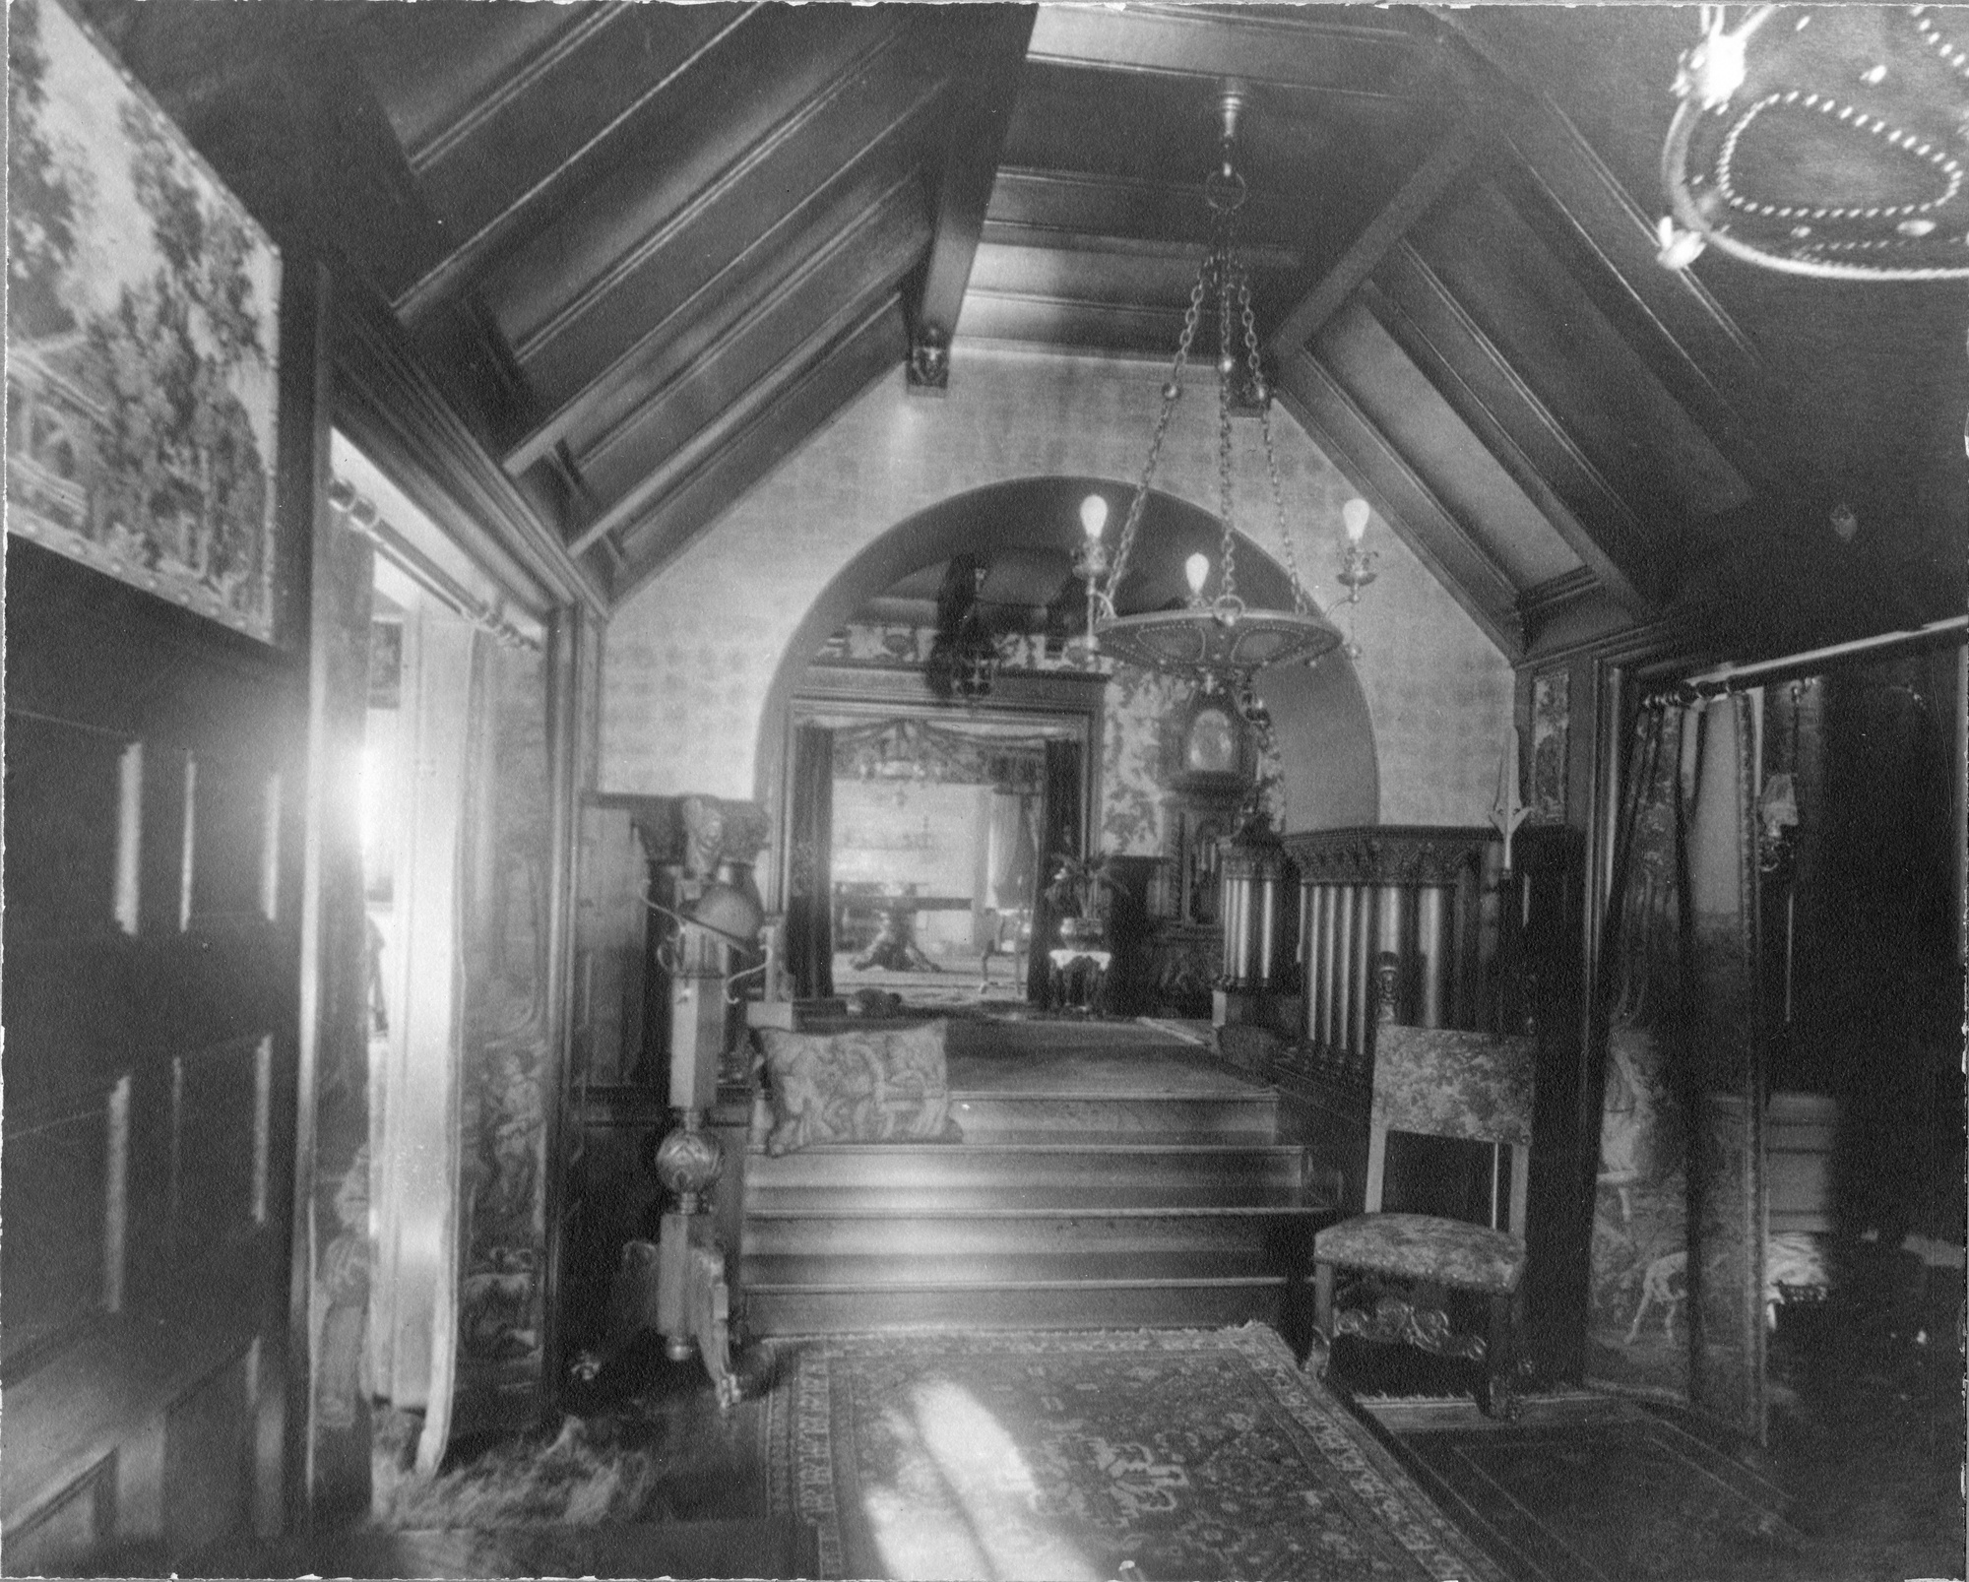
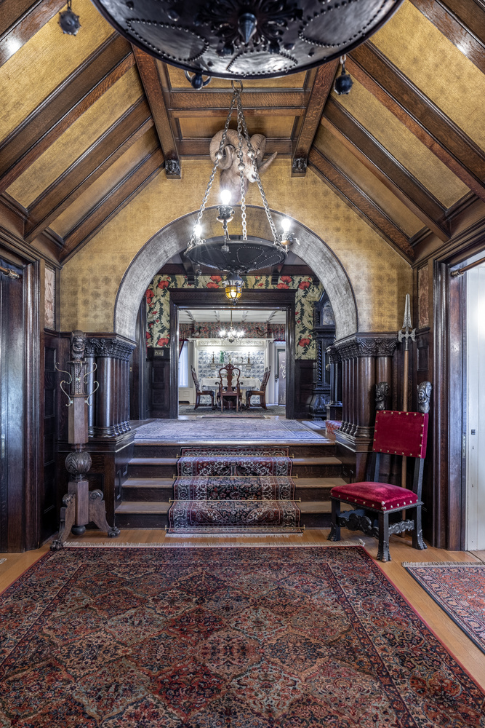
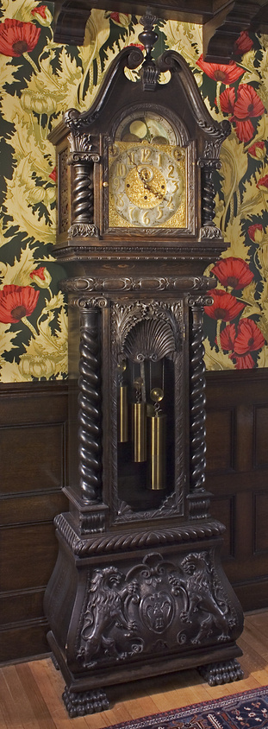
Northwest Museum of Arts and Culture,784.52A, Campbell Family Tall Clock, 1898, W.W. Powell Estate, 1973
Campbell House entry hall, 1910 The Joel E. Ferris Research Archives, Campbell House Collection, L91-120.27 and present (credit: Dean Davis)
The Arts and Crafts Revival architectural and decorative arts movement was a nostalgic look at pre-industrial times. When you walk into the house, you are meant to experience the feel of entering a great medieval hall. Much of the furniture and wall coverings you see today in Campbell House are the same ones guests gazed upon as they entered the home in 1910. After Grace’s death in 1924, Helen Campbell donated the house in her mother’s memory. It opened as a museum in 1926, holding and displaying the Eastern Washington Historical Society and the Spokane Art Association’s collections. After the donation, the home’s furniture was auctioned off or taken to Helen Campbell Powell’s home. The new Cheney Cowles museum opened to the public in 1960. At that time, the historical society started restoring the home to look as it did when the Campbell family owned it between 1898-1924. In the 1910 photo above, look for the Campbell’s Tall Clock. It still stands next to the entrance of the dining room, just as it did in 1898.
Notes:
Enter Campbell House
Arts & Crafts Revival: Medieval
Original furniture: Tall clock, Chair & coat rack
1925 auction
Furniture Powells did not want was auctioned off to raise money for the new museum.
With restoration a treasure hunt to find the auctioned off furniture

Slide 8
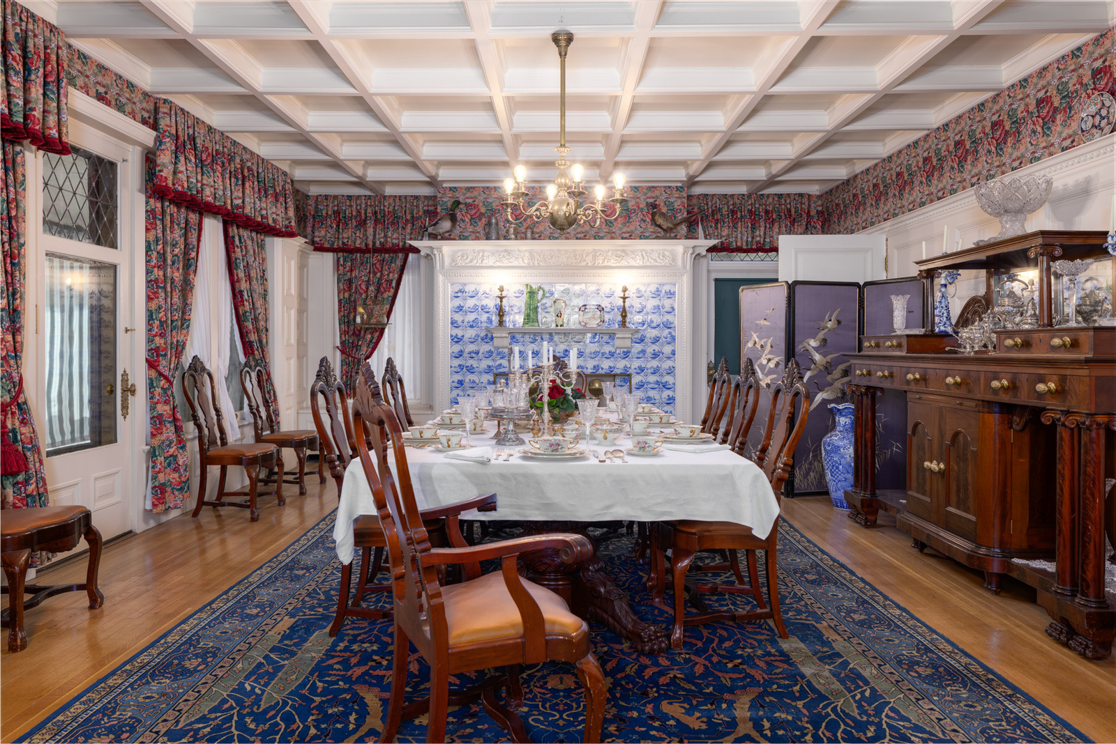
While standing in the house’s entry hall, your focus is directed towards the dining room. This Arts & Crafts Colonial Revival style dining room features Delft Tiles on the fireplace. Each tile has a different scene of Holland.
The dining room furniture is original to the house. When restoration of the home occurred, Mrs. Day, who had bought the dining room furniture during the auction, willed it back to the museum.
Imagine Mrs. Campbell presiding over a dinner party with friends in her beautiful, Edwardian silk dresses. Even when the family did not have guests, dinner was always in formal dress, with maids serving it in courses.
Photo credit:
Dean Davis
Notes:
Campbell House today
Dining room – Original furniture

Slide 9
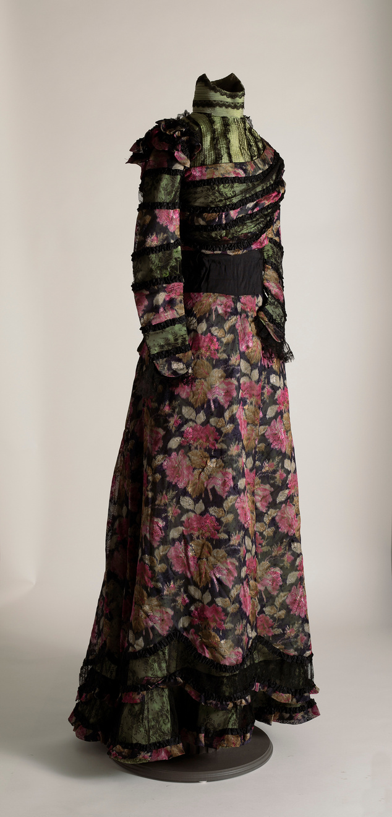
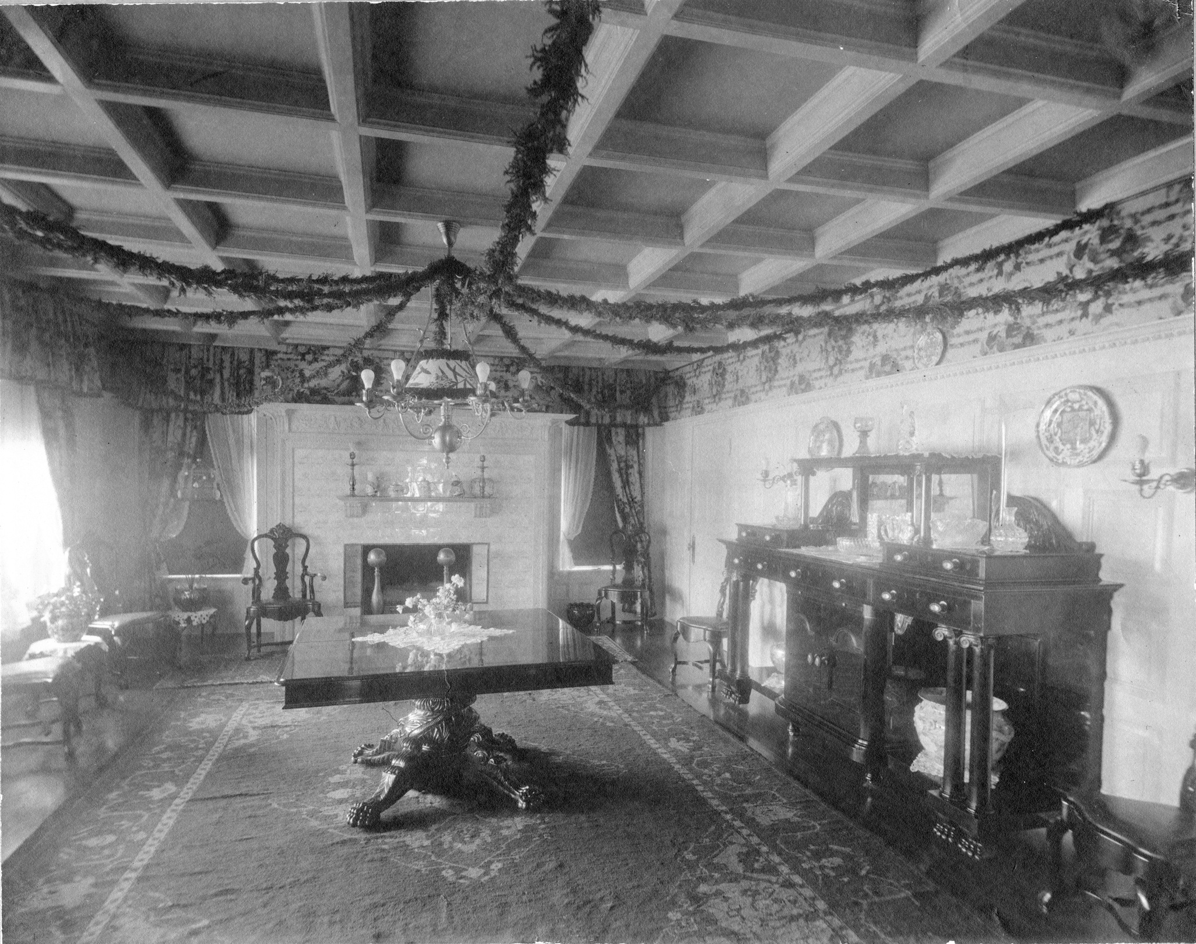
Northwest Museum of Arts and Culture,3965.3, Grace Campbell Silk dress, 1895-1915, Gift of June Powell, 2001
Campbell House dining room, The Joel E. Ferris Research Archives, Campbell House Collection, 1910, L91.120.3
Imagine Grace Campbell residing over a dinner party while wearing this beautiful Edwardian style silk dress.
Notes:
When you walk into Campbell House, your focus is directed towards the Dining Room
Arts & Crafts Colonial Revival
Features Delft Tiles on the fireplace. Each tile has a different scene of Holland.
The dining room furniture is original to the house.
When restoration of the home occurred, Mrs. Day who had bought the dining room furniture during the auction, willed it back to the museum.
Imagine Mrs. Campbell presiding over a dinner party with friends in this beautiful silk dress.
Even when the family did not have guests, dinner was always in formal dress, with maids serving.

Slide 10
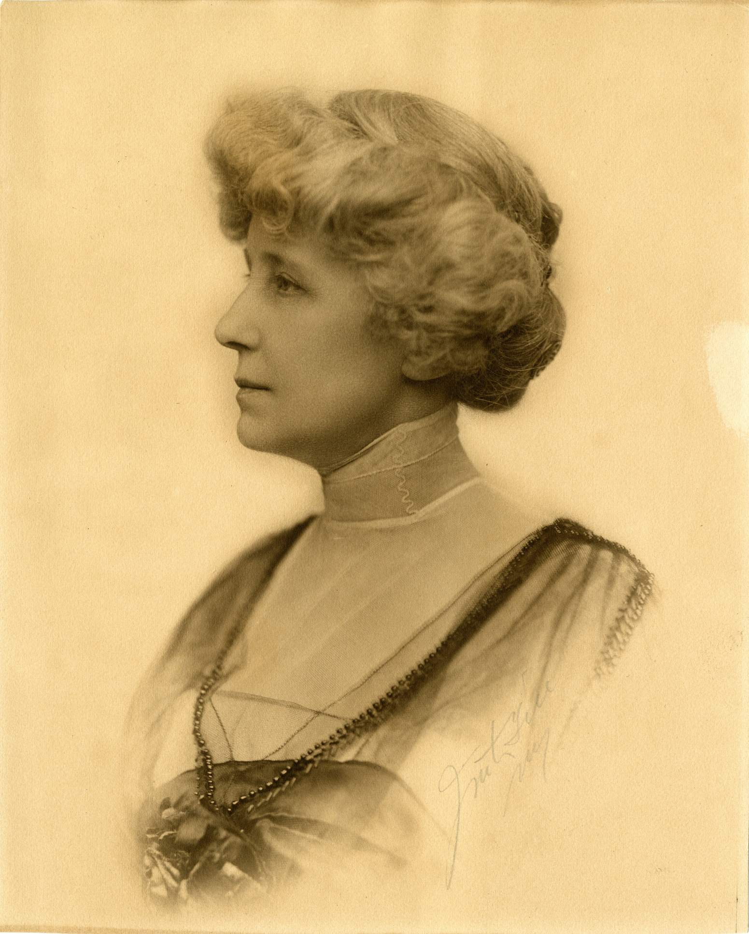
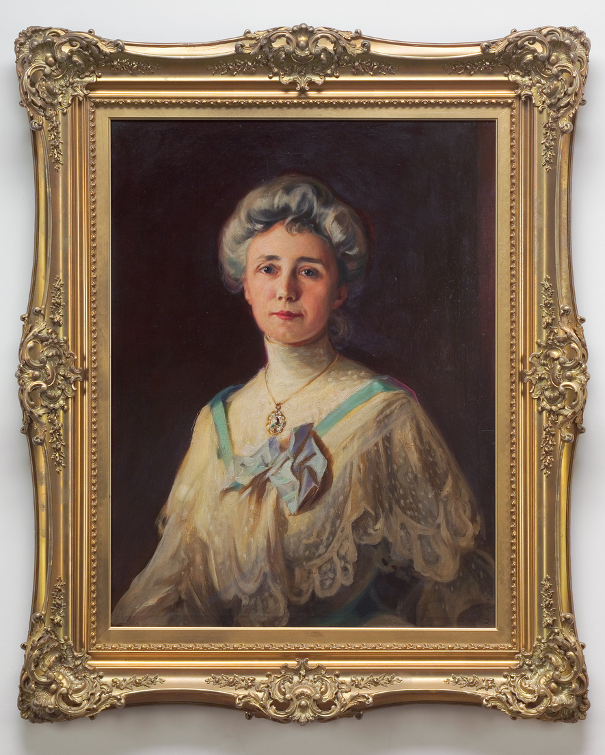
Grace Fox Campbell (1859-1924)
Grace was a schoolteacher until her marriage to Amasa Campbell in 1890 at the age of 31. On May 14, 1892, Grace gave birth to their only child, Helen. Grace devoted herself to the Victorian responsibilities of wife, mother, socialite, and household manager.
Her main responsibility was to manage the household. In 1910, running a mansion was like running a small business. She hired and directed staff, kept up correspondence, and paid bills. Along with her household management responsibilities, Grace was responsible for maintaining social friendships to help secure her husband’s status as an influential businessman.
Grace sympathized with the Progressive Movement reforms of her time, including the temperance movement and women’s suffrage. Washington’s equal vote amendment passed in 1910. While there is no evidence that Grace Campbell supported that measure, or ever voted, she did attend a tea in 1916 for 23 suffragists, including Elizabeth Cady Stanton’s daughter, Harriet Stanton Blatch. Grace’s daughter, Helen, recorded Grace and her attendance at the tea. Helen also recorded in her diary voting for Republican candidate Charles Evans Hughes over Woodrow Wilson during the 1916 Presidential Election.
Northwest Museum of Arts and Culture, 2485.2 Grace CampbellPortrait painted by Thomas Smith,1904, Gift of Bill and Helen Powell
Grace Campbell, The Joel E. Ferris Research Archives, Campbell House Collection, 1914, L84-187
Notes:
Grace Fox Campbell
Grace Fox (1859-1924)
Grace was a schoolteacher until her marriage to Amasa Campbell in 1890 at the age of 31.
On May 14, 1892, Grace gave birth to their only child, Helen Campbell.
Grace devoted herself to the Victorian responsibilities of wife, mother, socialite, and household manager.
Her main responsibility was to manage the household. In 1910, running a mansion was like running a small business.
She was also responsible for maintaining social friendships to help secure her husband’s status as an influential businessman.
Grace sympathized with Progressive reforms of her time the Temperance Movement and Women’s Suffrage.
Washington’s equal vote amendment that passed in 1910. Although there is no evidence that Grace Campbell supported that measure, or ever voted, she did attend a tea in 1916 for 23 suffragists, including Stanton’s daughter, Harriet Stanton Blatch. Her daughter, Helen, recorded when she voted for president in her diary.

Slide 11
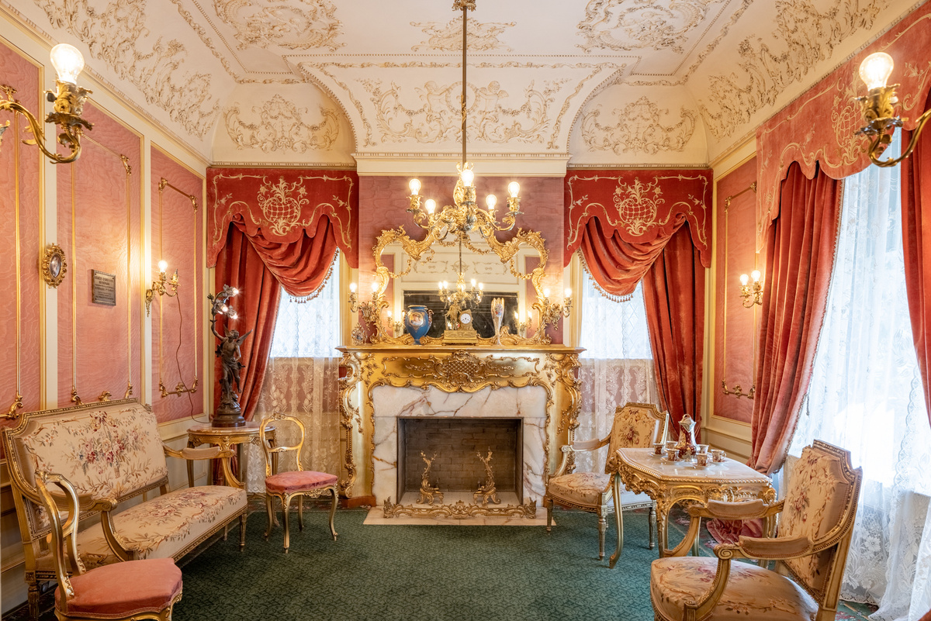
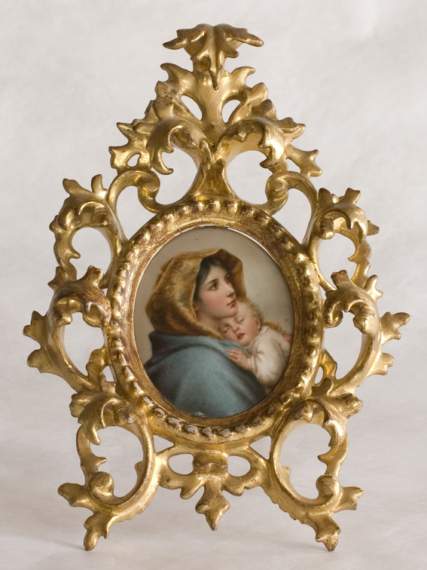
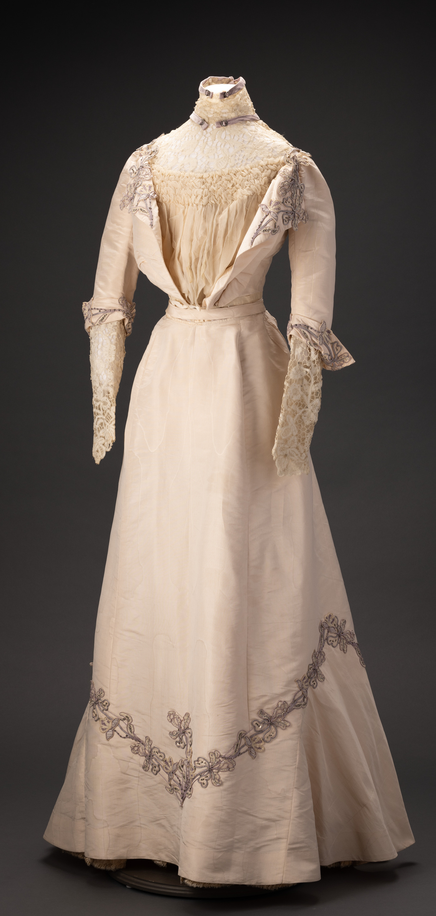
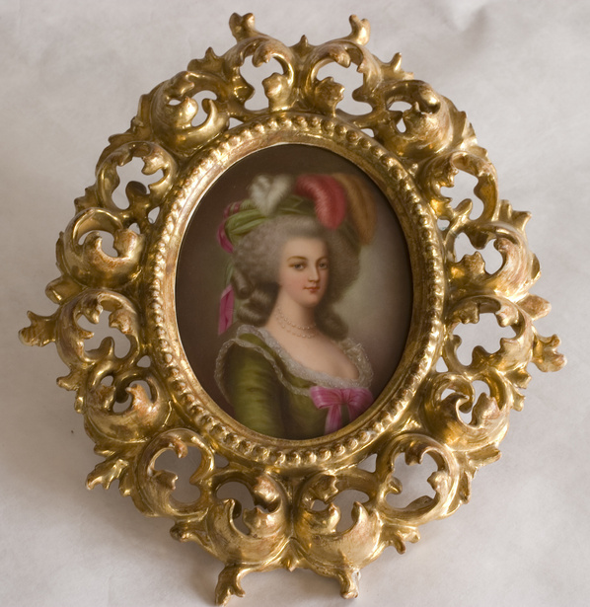
Campbell House Reception Room. Photo Credit: Dean Davis
Northwest Museum of Arts and Culture,784.28, Portrait of a Gentlewoman,1900-1915, Gift of Mr W. W. and Mrs. Helen Campbell Powell, 1960. Located in the Campbell’s Reception Room
Northwest Museum of Arts and Culture, 784.41, Madonna in gold frame,1910, Gift of Mrs. Helen Campbell Powell, 1960. Located in the Campbell’s Reception room.
The reception room is where Grace wore this elegant, but restrictive, reception dress. Grace was responsible for maintaining social friendships to help secure her husband’s status as an influential businessman and entertaining guests during reception days helped maintain those social bonds.
Reception days in Browne’s Addition were on Thursdays. The French Rococo style reception room, the receiving dress, and souvenirs from the family’s grand tour of Europe were outward signs of Mrs. Campbell’s position as a woman of wealth and a member of Spokane’s elite society.
Notes:
Here is where Grace wore that Reception dress from the previous slide.
Grace was responsible for maintaining social friendships to help secure her husband’s status as an influential businessman.
Reception Days and Calling Cards at Campbell House
The reception room, the dress, and souvenirs from the family’s grand tour of Europe represent a woman of wealth and society.

Slide 12
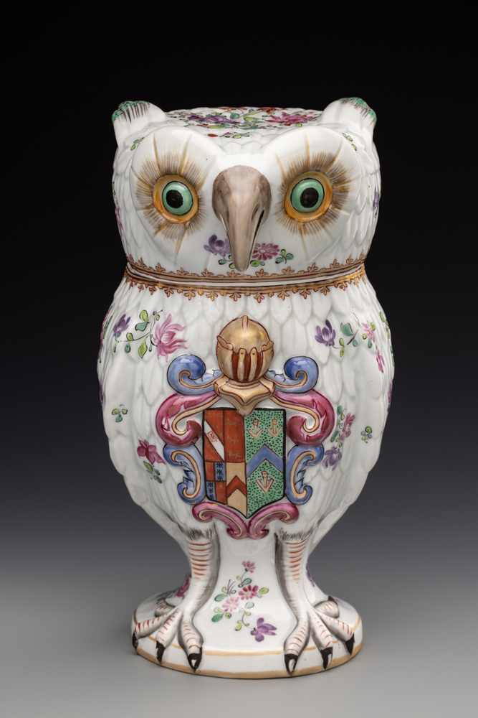
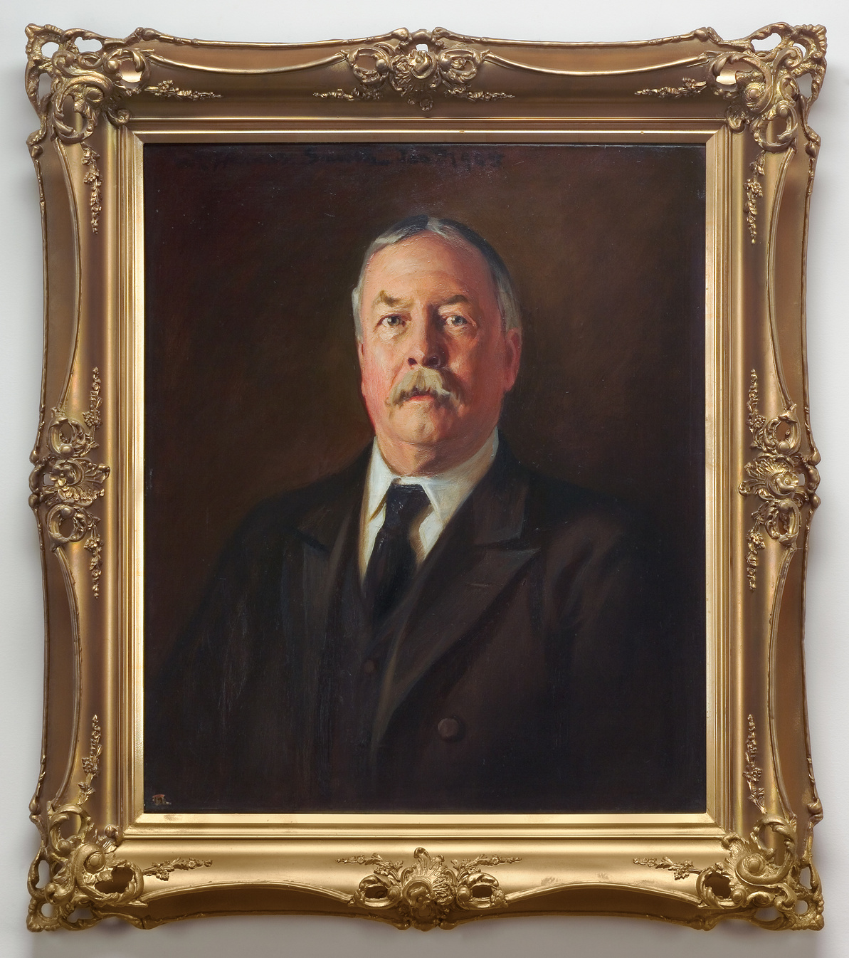
Amasa Campbell (1845-1912)
In 1887 Amasa Campbell and John Finch traveled to North Idaho to invest in silver mines. They hit it big with the Gem and Standard mines. Campbell and Finch eventually teamed up with Patsy Clark and founded the Hecla Mining Company. Campbell and Finch invested in a variety of business ventures, including the Coeur d’Alene Hardware Company which made mining machinery. They also invested in regional banks, real estate, logging, farming, and newly invented power generation such as the Wallace Electric Light Co.
Hard rock miners in silver mines worked a ten-hour day for $3.00 a day, six days a week. The deep rock mining that took place in the Coeur d’Alene mining district was both physically taxing and very dangerous. In 1892, the Mine Owner’s Association, which included Campbell and Finch, refused to give in to miner’s demands for higher pay and hired non-union workers and armed guards to break the unions. Riots broke out between the union miners and company guards which resulted in men killed and the non-union workers surrendering. The governor of Idaho instituted martial law, and the National Guard was sent to restore order.
The next year, in 1883, The Western Federation of Miners union was formed. More mining strife occurred in 1899 when union workers seized a railroad train and took it to Wardner, Idaho. At the Bunker Hill and Sullivan mine, the workers destroyed one of the world’s largest mining concentrators by detonating over 50 boxes of dynamite under it. Martial law was declared once again.
Violence in Wallace, paired with Spokane becoming the cultural and financial center of the Inland Northwest, played a part in the Campbells and other mine owners building their homes in Spokane’s Browne’s Addition.
Northwest Museum of Arts and Culture, 4429.19 Amasa Campbell Humidor, 1895-1905, Museum Purchase, 2019
Northwest Museum of Arts and Culture, 2485.1, Portrait of Amasa Campbell painted by Thomas Smith, 1904, Gift of Mrs. W.W. Powell
Notes:
Amasa Campbell (1845-1912)
In 1887 Amasa Campbell and John Finch to travel to North Idaho to invest in silver mines.
Hit it big with the Gem and Standard mines
Campbell, Finch, and Patsy Clark founded the Hecla Mining Company.
Campbell and Finch invested in other business ventures such as the Coeur d’Alene Hardware Company which made mining machinery.
They also invested in regional banks, real estate, logging, farming, and newly invented power generation such as the Wallace Electric Light Co.
In 1892, the Mine Owner’s Association
The miners worked a ten-hour day for $3.00 a day, six days a week.
The deep rock mining that took place in the Coeur d’Alene mining district was both physically taxing and very dangerous.

Slide 13
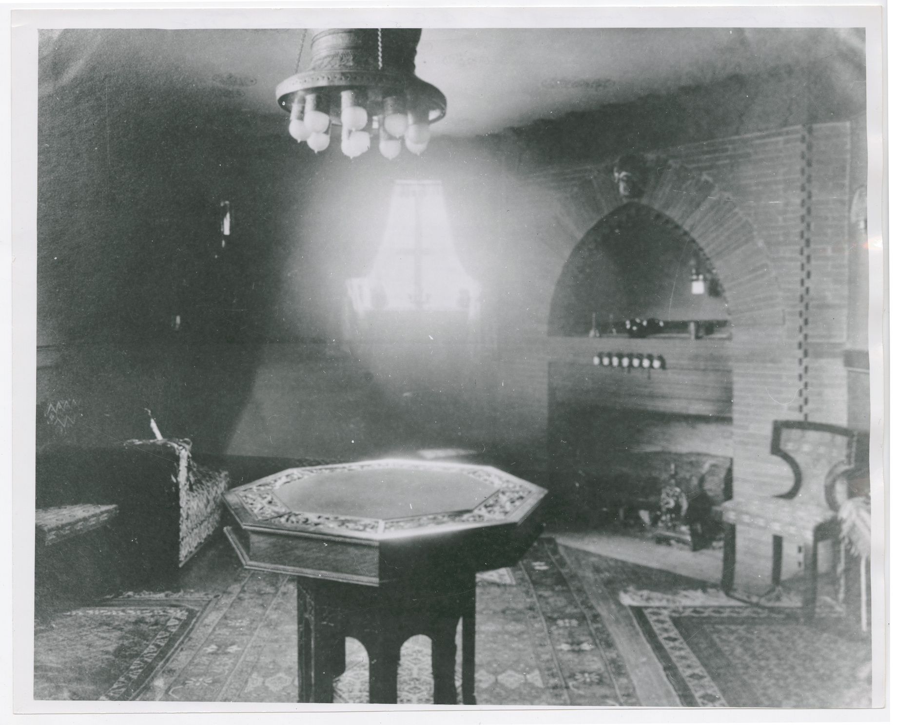
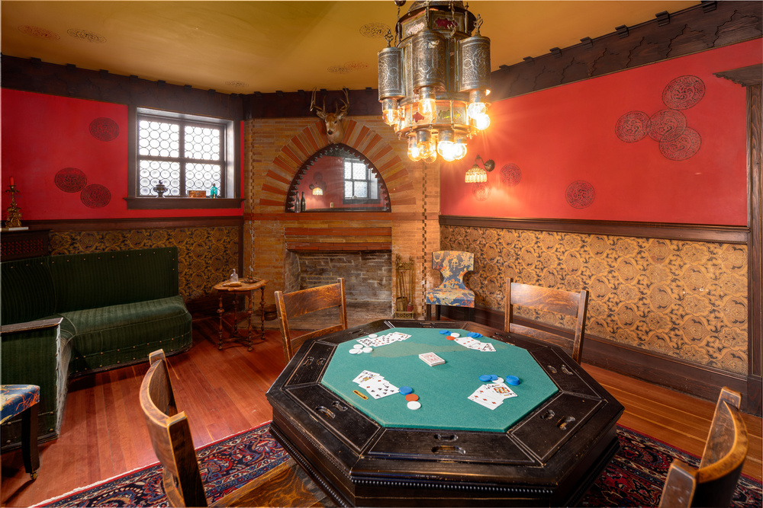
Mr. Campbell’s den as it looks today, Photos courtesy of Dean Davis
Amasa Campbell’s den, pictured here, was where the men retired after a dinner party to play cards and visit with each other.
Imagine the conversations that took place in this room.
Campbell House den, 1910, The Joel E. Ferris Research Archives, Campbell House Collection, L91-159.5
Notes:
Eventually, mine owners such as Amasa Campbell and John Finch moved to Spokane
Spokane had become the financial and cultural center of the region.
Amasa Campbell’s den, pictured here, was where the men retired after a dinner party to play cards and visit with each other.
Imagine the conversations they had while smoking cigars and playing poker.

Slide 14
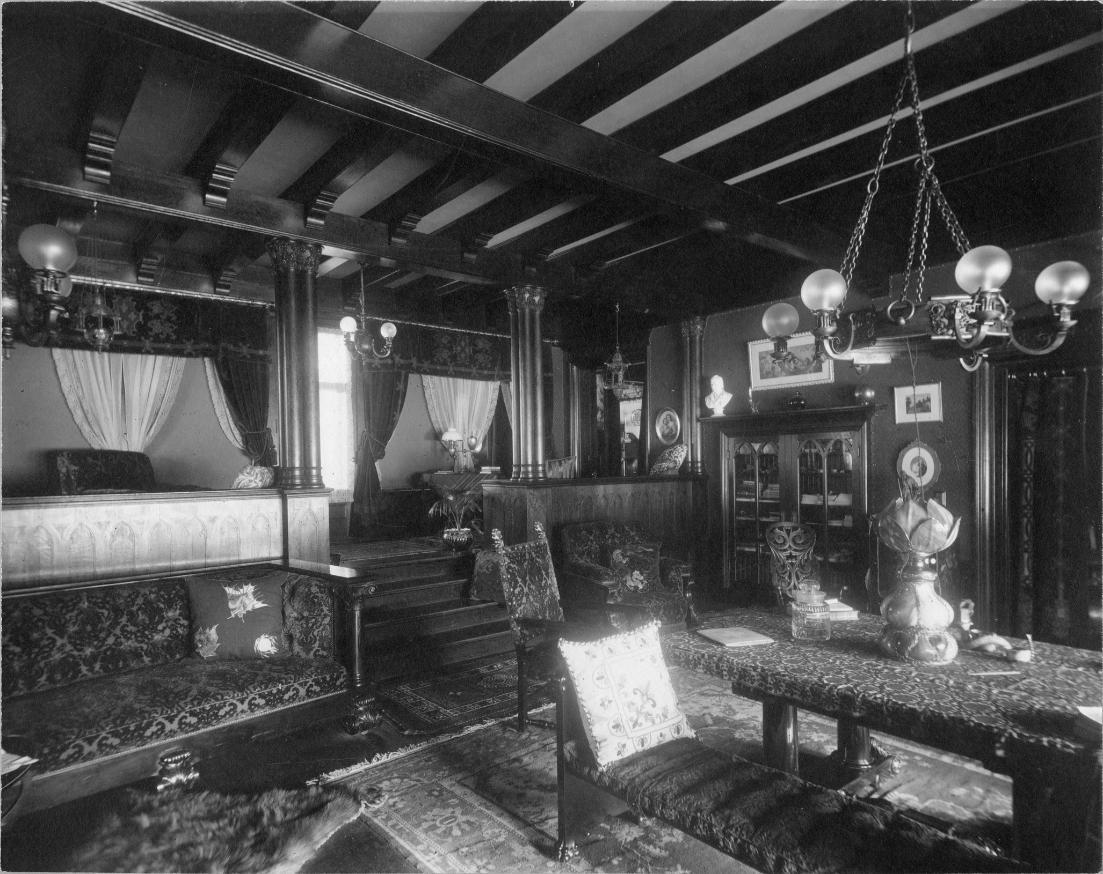
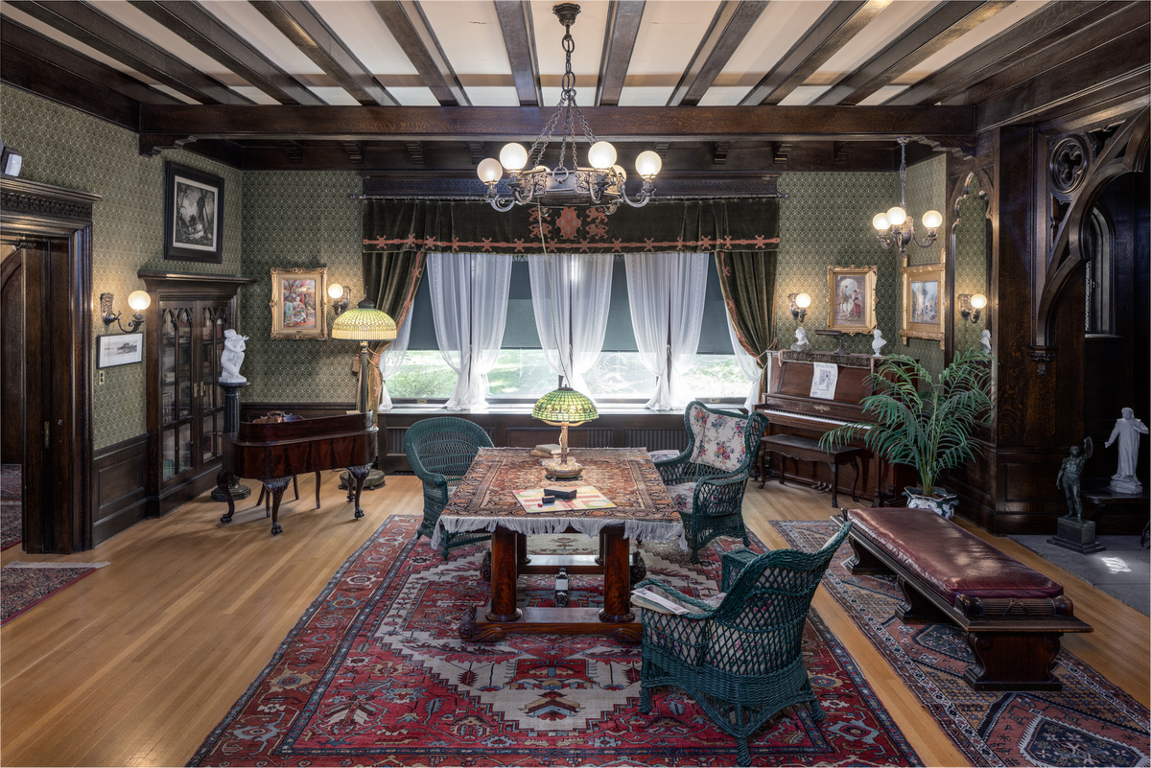
Campbell House Library, The Joel E. Ferris Research Archives, Campbell House Collection, 1910, L91.120.28
Campbell House Library as it looks now. Helen and her friends enjoyed playing board games such as Parcheesi. Photo Credit: Dean Davis
The library is where the family spent most of their time. Entertainment at home included dances, music recitals, board games, reading, sewing circles, and dinner parties. The library was also the room where important family events occurred. Helen Campbell’s 1917 wedding to Bill Powell was held in the library. The funerals of both Amasa Campbell in 1912 and Grace Campbell in 1924 were also held in the library. Much of the furniture you see in the Campbell House library today is orignal furniture from when the Campbells lived in the home. Take a close look at this room. What do you see?
Notes:
The library is where the family spent most of their time.
Entertainment at home included dances, music recitals, board games, reading, and dinner parties.
The Library was also the room were the family held weddings and funerals.

Slide 15
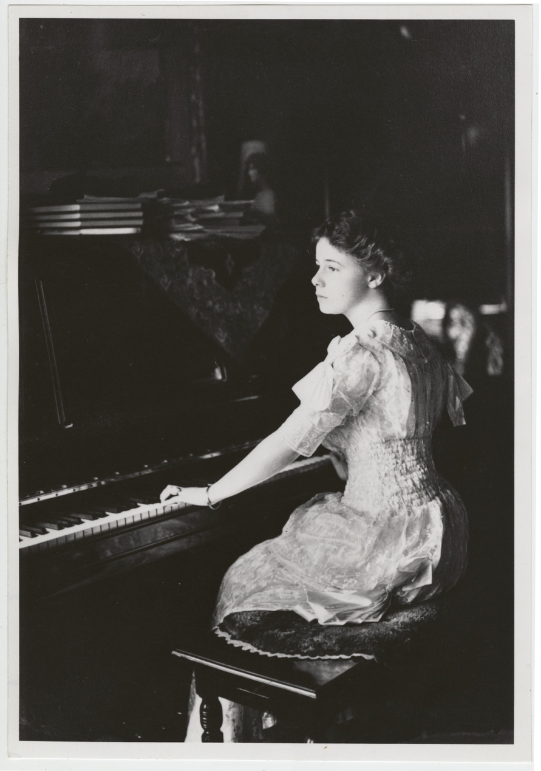
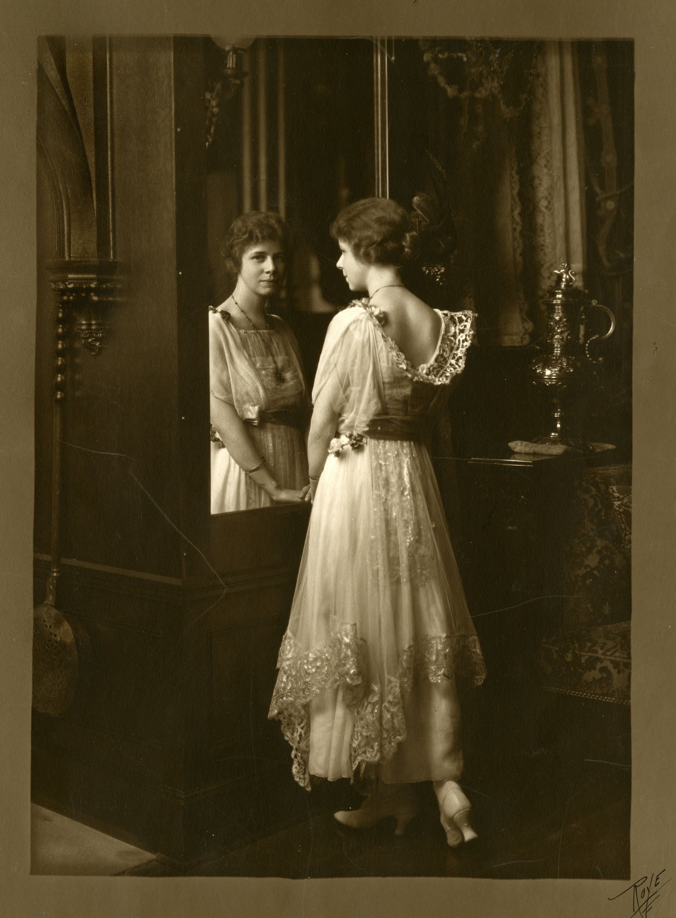
Helen Campbell (1892-1964)
Helen was the only child of Amasa and Grace Campbell. She was six years old when they moved into the house and lived there until just after her marriage, at the age of 25, to Bill Powell in 1917. Helen’s generation were considered “New Women”. She and her friends enjoyed sports and outdoor activities. Their dresses were shorter and less restrictive than Grace’s generation. Their hair was bobbed, and technology was rapidly changing. Cars replaced horses and carriages; homes were electrified; telephones were available, as well as radios and moving pictures.
Helen is pictured here in the library. She loved attending dances; participated in music recitals; enjoyed board games and reading; and she was both invited to and hosted many dinner parties and “Tango Teas”.
The Castle Walk (Irene and Vernon Castle), The Fox Trot, and The Tango were popular dances that Helen talks about in her Line a Day diary she kept between 1913-1917. We know a great deal about Helen’s daily activities and friends from that diary.
The Joel E. Ferris Research Archives, Helen Campbell, 1911, L91-118.13, Campbell House Collection, This was taken the same year as Helen’s “Debut” into Spokane’s society.
Helen Campbell, The Joel E. Ferris Research Archives, Campbell House Collection, 1908, L91.119.1
Notes:
Helen Campbell (1892-1964) Only child of Amasa and Grace Campbell.
Helen was six years old when they moved into the house.
Helen’s generation were considered “New Women”.
Helen and her friends enjoyed sports and outdoor activities.
Dresses were shorter and less restrictive.
Hair was bobbed.
Technology was rapidly changing.
Cars replaced horses and carriages; homes were electrified; telephones were available, as well as radio and moving pictures.
Helen is pictured here in the library where the family spent most of their time.
Entertainment at home included dances, music recitals, board games, reading, and dinner parties.
The Castle Walk (Irene and Vernon Castle), The Fox Trot, and The Tango were popular dances that Helen talks about in her diary.

Slide 16
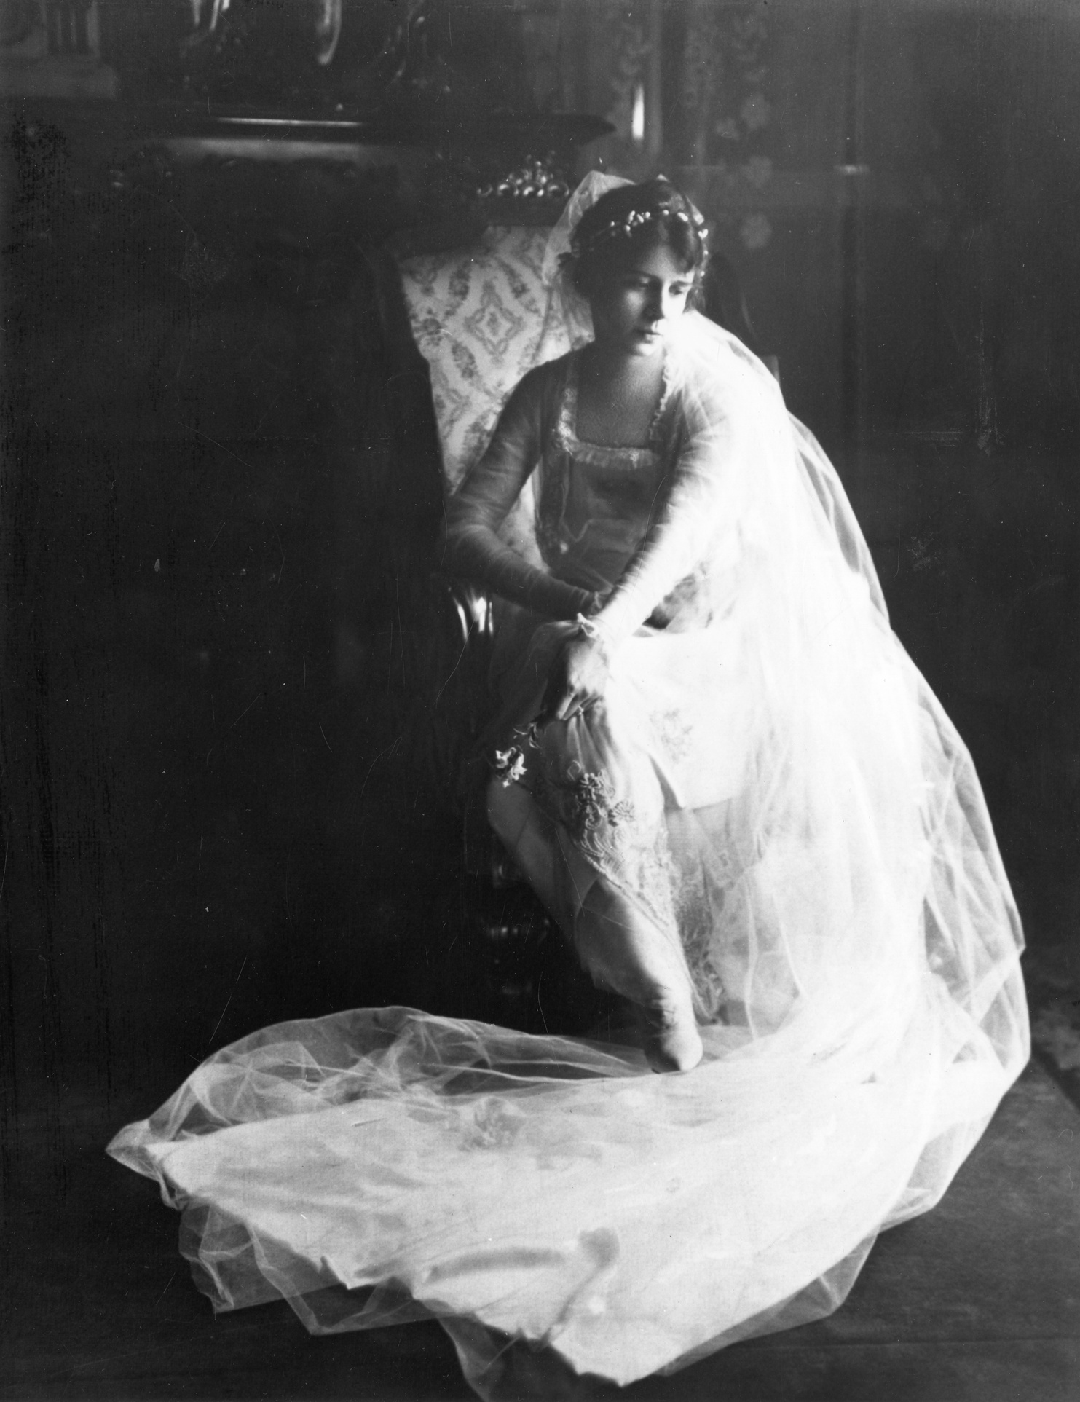
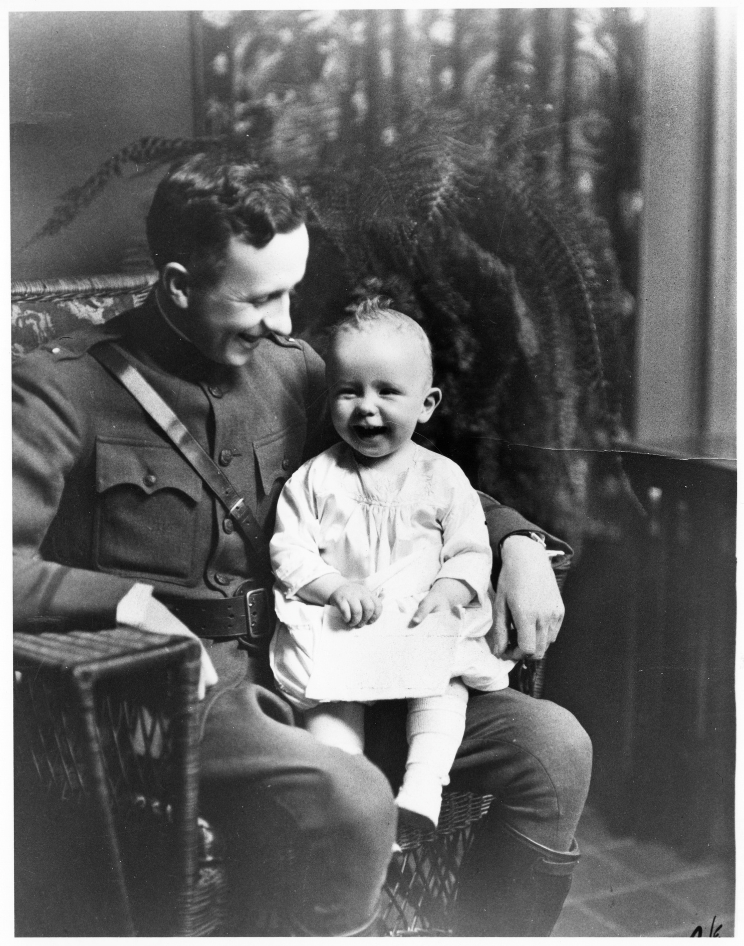
Helen Campbell married Bill Powell (1888-1972) in 1917. The marriage took place just before Bill was sent to serve in France during WWI. Helen lived with her mother during this time.
After Bill’s return, he resumed his business in the timber industry and the couple had three sons together. They raised them in Spokane and British Columbia.
WWII produced tragedy for the family when their middle son, Allan, a WWII Bomber pilot was killed when his plane went down over Europe. Their oldest son, Bill, served in the Pacific and the youngest son, John, was a musician with the USO, entertaining the troops in Europe.
Helen and Bill’s generation saw great changes in the United States. When they were born, horses, carriages, and railroads were the main forms of transportation. During their lifetimes, they experienced two World Wars; a technology boom that included radios, televisions, and movies; as well as the advent of automobiles, airplanes, and astronauts landing on the moon.
Bill Powell and son, 1918, The Joel E. Ferris Research Archives, Campbell House Collection, L91-120.9
Helen Campbell, The Joel E. Ferris Research Archives, Campbell House Collection, 1917, L91.159.41
Notes:
Helen’s Line a Day Diary from 1913-1917.
Marries Bill Powell in 1917.
After Bill’s return, he resumed his business in the timber industry and the couple had three sons together, raising them in Spokane and British Columbia.
The library was also the room were the family held weddings and funerals.

Slide 17
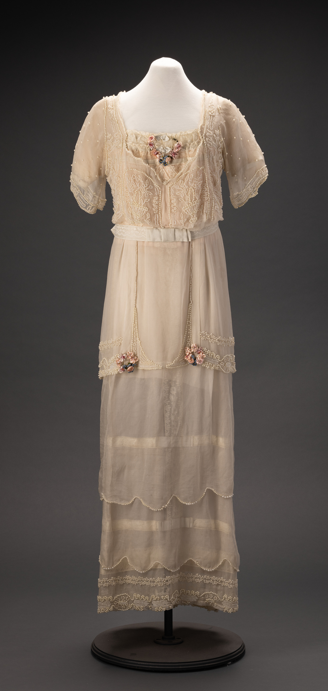
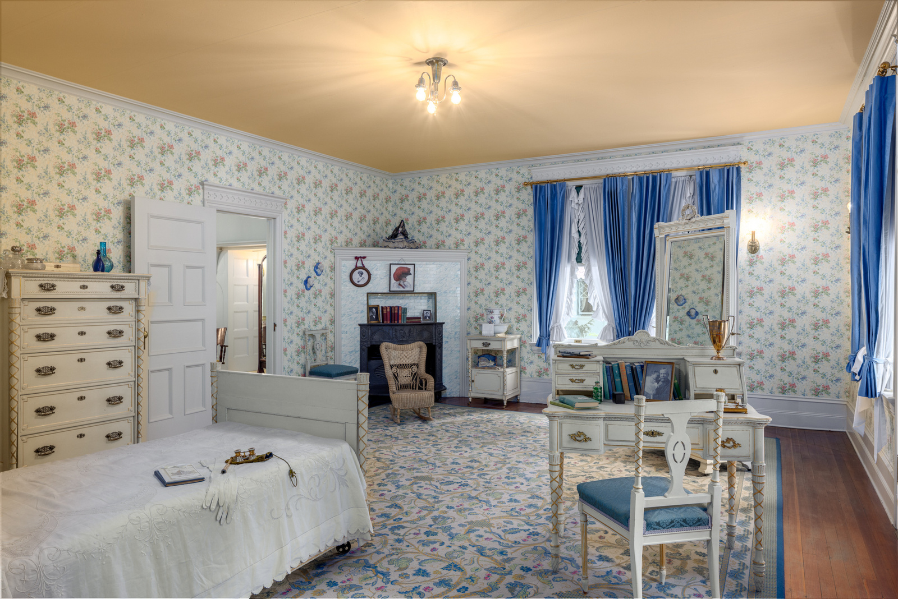
Can you imagine Helen as a young child playing in this bedroom with her neighborhood friends? This 1914 frock could have been a dress chosen from her wardrobe that was worn while dancing The Tango during a “Tango Tea”.
Photo Credit: Dean Davis
Helen Campbell’s Childhood bedroom
Northwest Museum of Arts and Culture
43096.2, Helen Campbell Frock, 1914, Gift of Valerie Powell 1985
Notes:
Second Floor Family Bedrooms
Helen Campbell’s childhood room.
Amasa and Grace’s bedroom
Guest bedroom
Helen and Bill’s first child
Helen Campbell’s diary

Slide 18
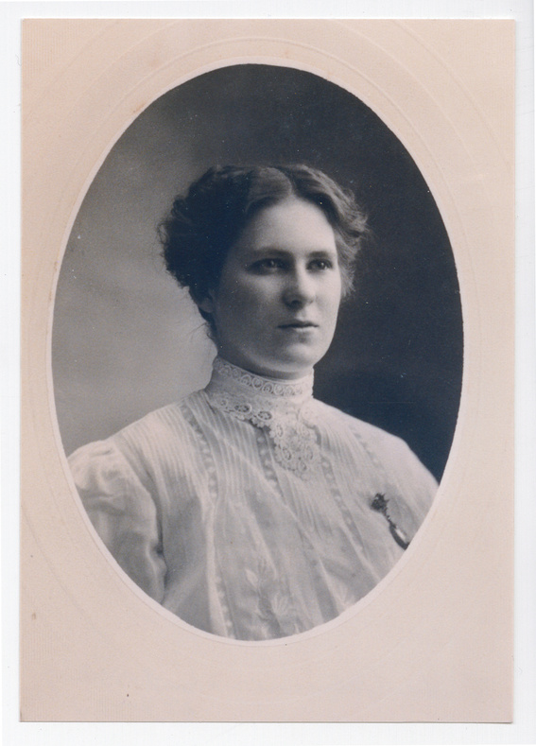
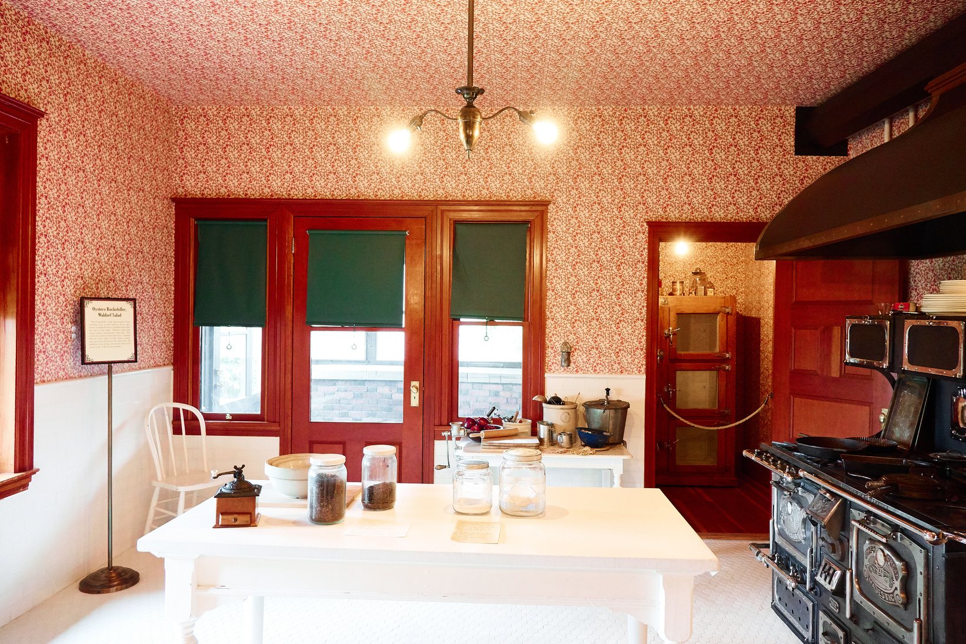
Hulda Johnson, Campbell House Cook, The Joel E. Ferris Research Archives, Campbell House Collection, 1906-1907, L94-40.1
Hulda Johnson Olson (1880-1967)
Hulda followed her cousin and two of her brothers who had immigrated from Solsett, Sweden to the United States. Hulda first settled in Chicago, finding employment working for the manager of the Marshal Field Department Store. She then decided to join her brothers in Spokane, WA.
Hulda first went to work for D.C. Corbin and Joseph Drumheller and was eventually hired as the Campbell’s new cook. Hulda began her days by 6:00am, cooking meals for both the family and the servants. Her day ended only after the family and their guests finished their dinner meal, which if it was for a dinner party, could have ended late into the night. After dinner was served, dishes, tables, floors, and the stove would have all needed a thorough cleaning and everything ready to start again in the morning. Servants in Campbell House ate the same meals as the family, however, the servants and the family had separate dining rooms and ate at separate times.
Working class people in Spokane could easily travel around the region on trolleys or trains. On their one day off a week, they could go shopping in downtown Spokane, see a movie, or maybe go to Liberty Lake or Natatorium Park with their friends to dance and swim. Hulda met her future husband, Louis Olson, as he was delivering milk to the neighbor’s house. They married in December 1907, and she continued to work for the Campbell family an additional six months until she and her husband opened a restaurant in Idaho.
Notes:
Hulda immigrated from Solsett, Sweden.
Her cousin and two of her brothers had already moved to the United States.
Hulda first settled in Chicago, finding employment working for the manager of the Marshal Field Department Store.
Hulda then decided to join her brothers in Spokane.
She first went to work for D.C. Corbin and Joseph Drumheller.
She was eventually hired as the Campbell’s new cook.
Hulda would have cooked meals for both the family and the servants.
Servants in Campbell House ate the same meals, however, the servants and the family had separate dining rooms.
Working class people in Spokane could easily travel around the region on trolleys or trains. On their one day off a week, they could go shopping in downtown Spokane, see a movie, or maybe go to Liberty Lake with their friends to dance and swim.
Hulda married Louis Olson in December 1907 but continued to work for the Campbell family an additional six months until she and her husband opened a restaurant in Idaho.

Slide 19
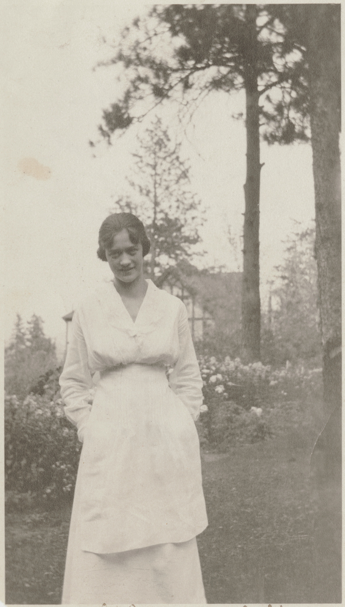
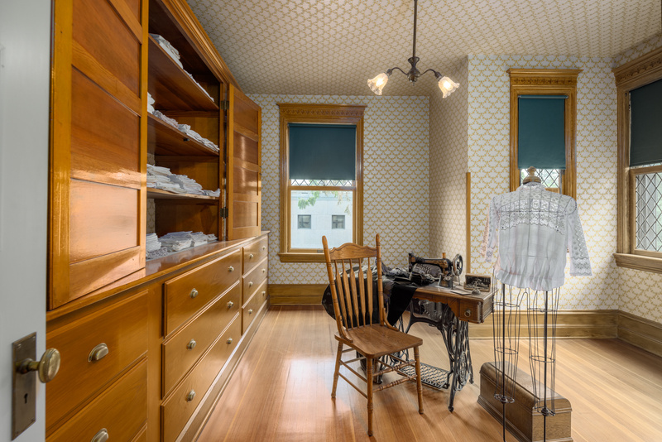
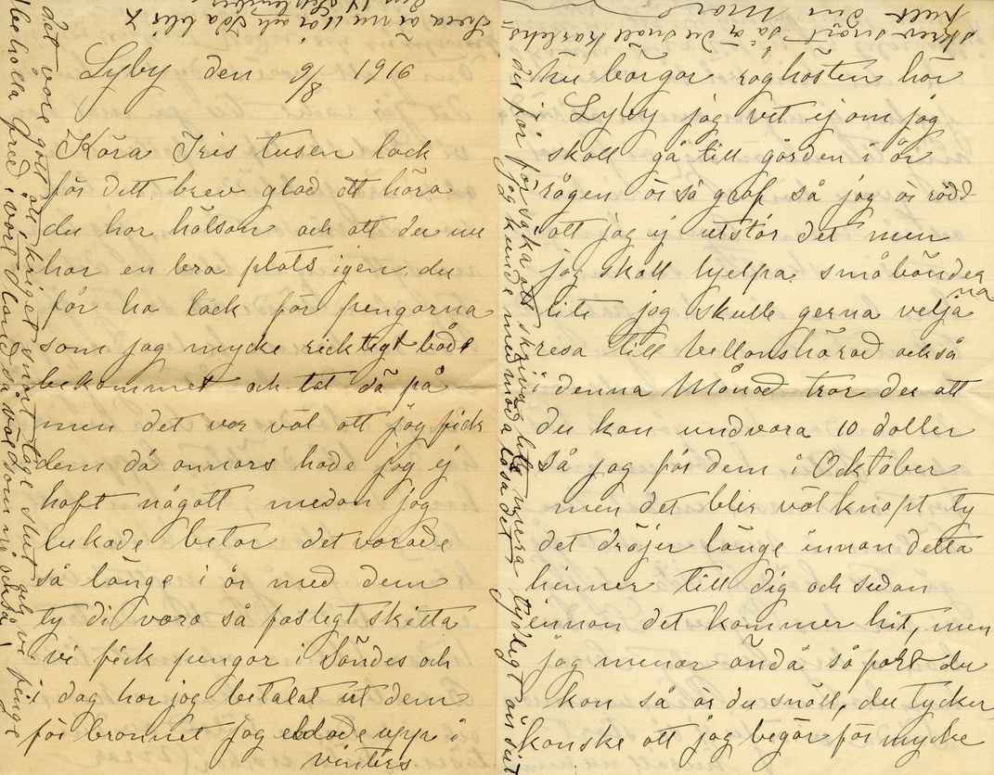
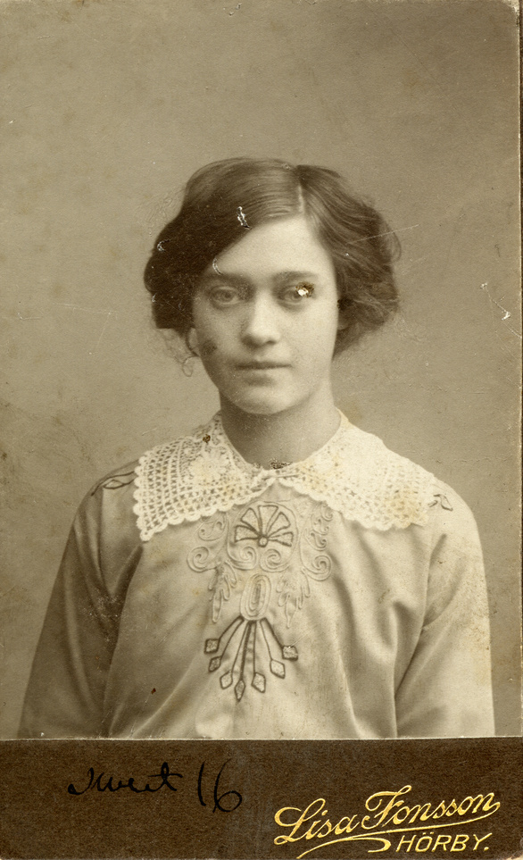
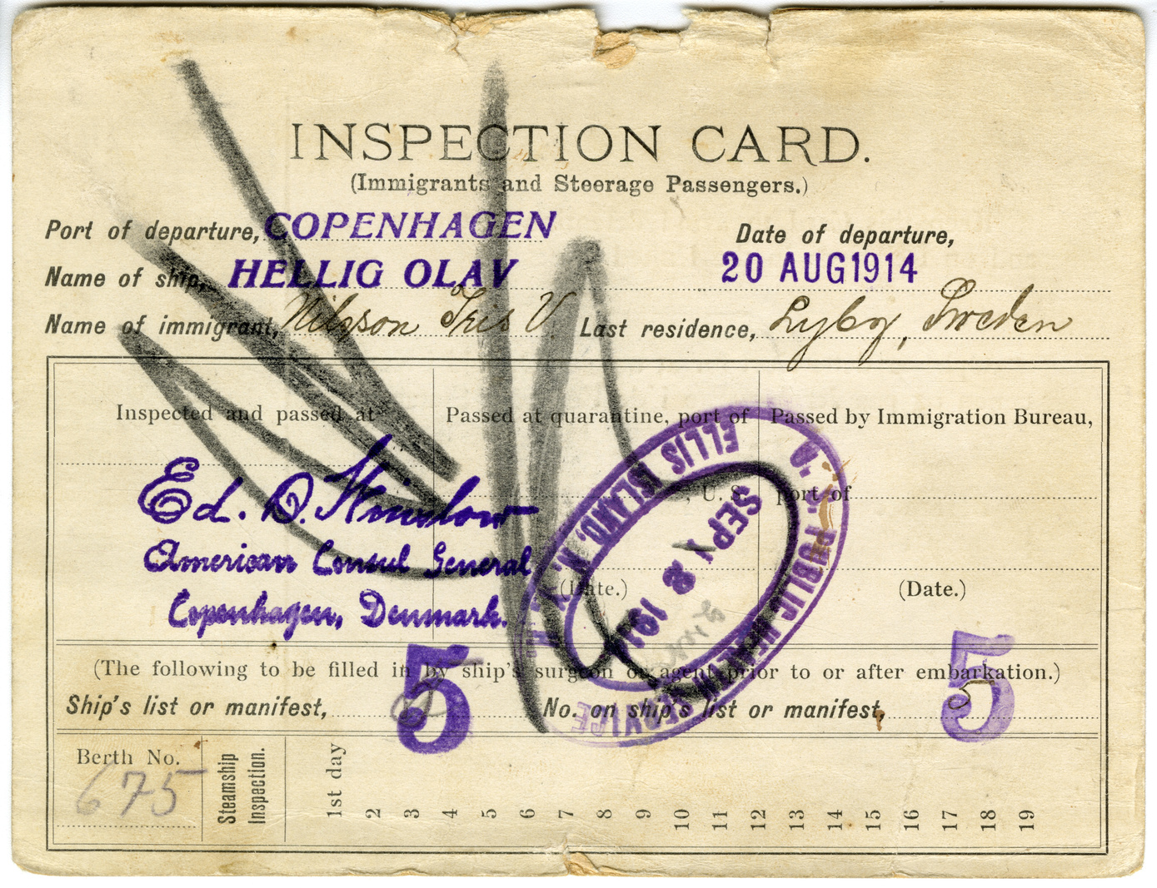
Iris Nelson (1898-1973): Campbell House Maid
Iris Nelson immigrated from Sweden to Whitefish, Montana in 1914 after her sister, Alma, paid her passage. Iris was sixteen years old. She soon moved to Spokane finding work as a 2nd floor maid in Campbell House.
Iris came from a poor farming family and promised to send money back to her mother who still lived in Sweden with Iris’ younger siblings. She was hired by the Campbell family as the upstairs maid. First floor maids set tables and served meals, answered the door, swept and dusted the main floor, and helped the cook. The second floor, or chamber maid, swept and dusted the upper floor, made beds, laid out clothing, assisted the family personally, and helped the cook or first floor maid as needed. Maids made $20.00 - 25.00 per month, plus room and board. Iris was paid extra for her fancy work that included crochet and embroidery projects.
Iris met Jack Fruin while on a double date. Jack was stationed at Spokane’s Fort George Wright, and the two soon married. Iris worked for Mrs. Campbell for a few months after her marriage while Jack was serving in WWI.
The Joel E. Ferris Research Archives, Campbell House Collection, Iris Nelson Fruin letter from family in Sweden and Immigration Inspection card, 1916-1920,
,The Joel E. Ferris Research Archives, Campbell House Collection, Maid Iris Nelson in the backyard of Campbell House, 1919, L88-251.1
,The Joel E. Ferris Research Archives, Campbell House Collection, Iris Nelson Fruin, 1914, L91.119.1
Notes:
Iris Nelson immigrated from Sweden to Whitefish, Montana in 1914 after her sister, Alma, paid her passage from Sweden to Montana.
Iris was sixteen years old
Iris soon moved to Spokane finding work as a 2nd floor maid in Campbell House.
She was paid extra for her fancy work.

Slide 20
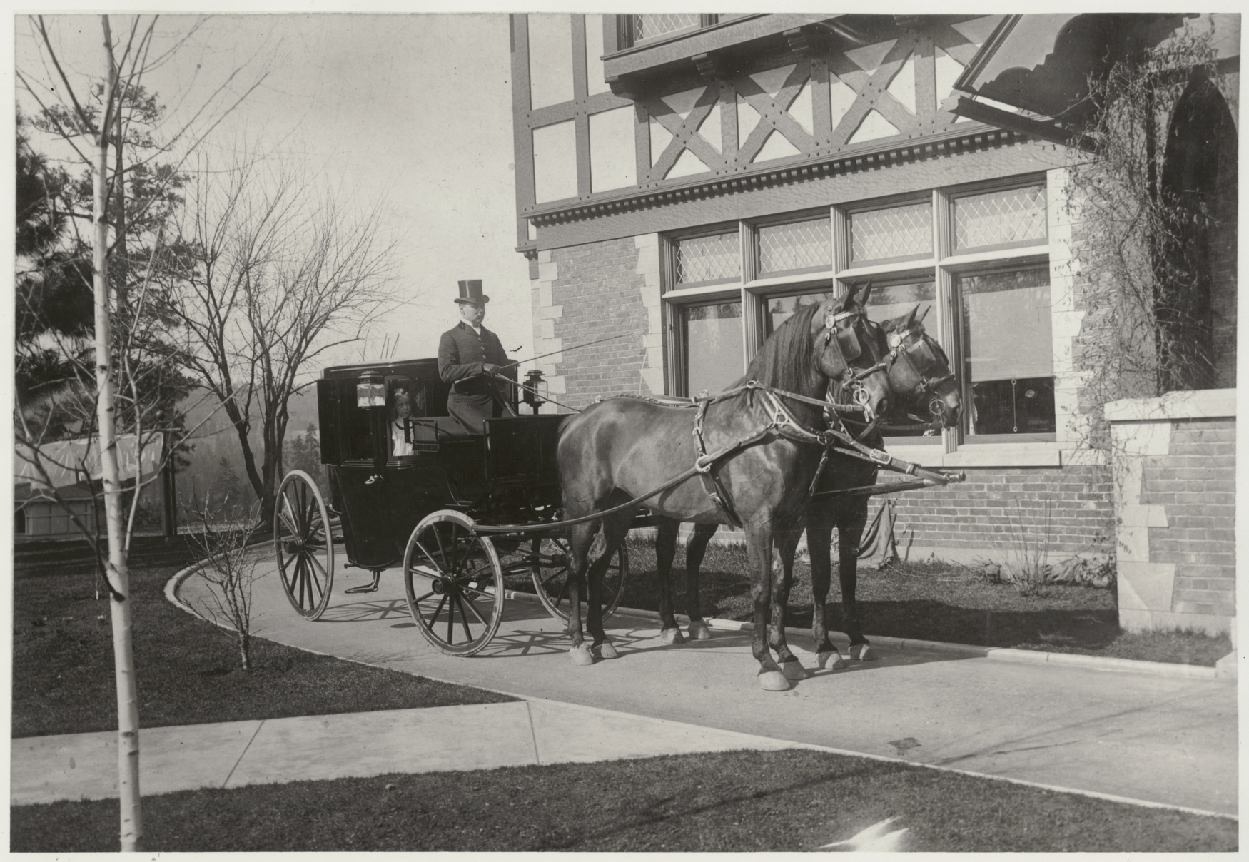
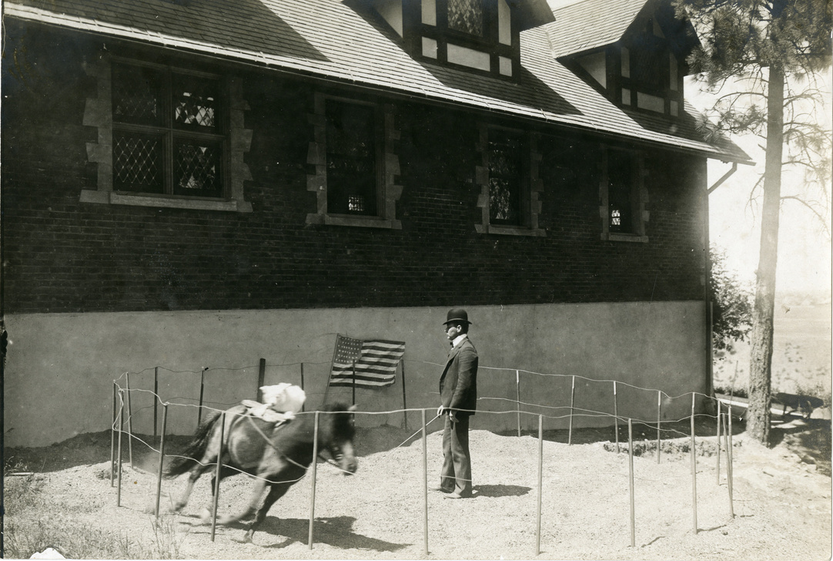
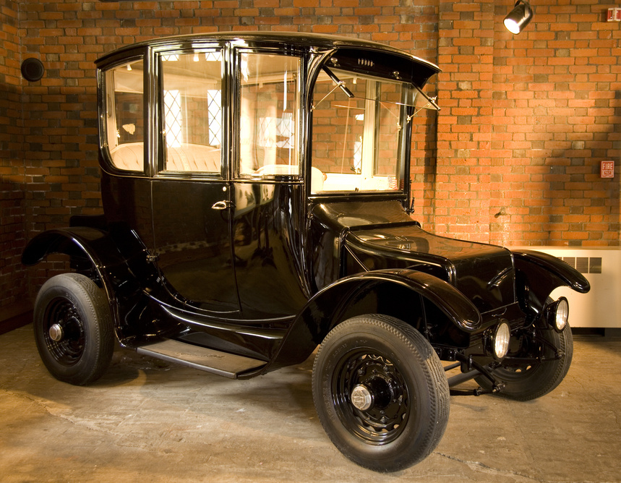
Joseph Gladding, 1898, The Joel E. Ferris Research Archives, L91-118.3 Campbell House Collection, 1900-1905
Carriage House Coachman: Joseph Gladding (1871-1944)
Raised on a large farm near Youngstown, Ohio, Joseph Gladding grew up with horses.
By the age of ten, he could break colts and handle a team. He learned animal training by watching circus trainers when they worked on their acts at the winter headquarters near his home.
Joseph first met Amasa Campbell in Youngstown while Campbell was in town to purchase three driving horses and a pony. On June 5, 1898, the 27-year-old arrived in Spokane to serve as the family coachman.
His work paid well, during the seven years he worked at Campbell House, on average, Mr. Campbell gave him a $10.00 a month raise once every year. His wages averaged $75.00 a month and included room and board. Mr. Gladding met his wife, Nora Moriarty, who was the Campbell House cook when they both worked in the house. Mr. Gladding said of his wife, “I have had a great cook ever since and a good wife. And you should see her beautiful flower garden.”
In a 1938 Spokesman Review interview, Gladding said that he followed Mr. Campbell’s example and invested some of his wages in mines and real estate. Eventually, he and Nora opened a furniture store on Monroe Street. They operated the business for fifteen years.
Mr. Gladding, like all coachmen of his generation, grew up with and were experts at working with horses. His skill with animals included training Helen’s pony and dog to do circus acts to entertain her and her friends.
Automobiles made the job of a coachman obsolete. The Campbells bought their Rauch and Lang Electric car in 1913. After that, instead of a coachman, the family hired a chauffeur.
Northwest Museum of Arts and Culture, 175.148 Rauch and Lang Electric Car, 1915-1916, Gift of Agnes McDonald, 1951
Notes:
Carriage House Coachman: Joseph Gladding
Raised on a large farm near Youngstown, Ohio, Joseph Gladding grew up with horses.
By the age of ten, he could break colts and handle a team.
He learned animal training by watching circus trainers when they worked on their acts at the winter headquarters near his home.
Joseph first met Amasa Campbell in Youngstown while Campbell was in town to purchase three driving horses and a pony.
On June 5, 1898, the 27-year-old arrived in Spokane to serve as the family coachman.
His work paid well, during the seven years he worked at Campbell House, on average, Mr. Campbell gave him a $10.00 a month raise once every year. His wages included room and board.
Mr. Gladding met his wife, Nora Moriarty, at Campbell House. Nora was the cook.
In a 1938 Spokesman Review interview, Gladding said that he followed Mr. Campbell’s example and invested some of his wages in mines and real estate.
Eventually, he and Nora opened a furniture store on Monroe Street. They operated the business for fifteen years.
Mr. Gladding, like all coachmen of his generation, grew up with and were experts at working with horses and even trained Helen’s pony and dog to do circus acts to entertain her and her friends.
Automobiles made the job of a coachman obsolete.
The Campbells bought their Rauch and Lang Electric car in 1913. After that, instead of a coachman, they hired a chauffeur

Slide 21
Using Primary Sources
How do we know about the lives of Amasa, Grace, Helen, Hulda, Iris, and Joseph? Museums collect primary sources which provide firsthand evidence about a topic, event, or individual. Primary sources include documents, photos, oral histories, and objects about the people we are studying. We have a treasure trove of Campbell House primary sources that have been gathered over the last 100 years!
Analyzing Primary Sources: Photographs
Photographs provide us with images of past events. Today, historians study the content and meaning of these visual images to locate information about a particular topic, time, or event. Photographs can convey countless details about life. For historians and for us, “A picture is worth a thousand words.” Photographers can manipulate, intentionally or unintentionally, the record of the event. It is the photographer – and the camera’s frame – that defines the picture’s content. Thus, the photographer chooses what will be in the picture, what will be left out, and what the emphasis will be. When analyzing photographs, ask yourself the following questions:
  Take a closer look: Make sure to examine the whole photograph. Make a list of any people in the photograph. What is happening?
  Looking more closely: Are there any captions? A date? Location? Names of people? What kind of clothing is worn? Are there any words on signs or buildings?
  Thinking Further: If people are in the photograph, what do you think is their relationship to one another? Can you speculate on a relationship between the people pictured and someone who is not in the picture?
  What do you think happened before and after the photo was taken? Who do you think took the photo and why?
  What does this photograph suggest to you? What questions do you have about the photo? How could you try to answer them?
  What is the one thing that you would remember most about this photograph and why?
  What questions do you have about the photograph that you cannot answer through analyzing it? Where could you go next to answer these questions?

Slide 22
Analyzing Primary Sources: Objects
Historians study objects, the material culture that people from the past left behind, in order to understand history. Objects are the products of human workmanship - of human thought and effort - objects tell something about the people who designed, made, and used them. What questions do historians ask themselves when they analyze objects?
  First impressions: What are your first impressions of this object? Do you have any ideas what the object might have been used for?
  A closer look at the physical features: What is it made of? Why was this material chosen? What is the texture and color? What does it smell like? Can it be held? Is it heavy or light? Is it intact, or does it look like parts are missing? Does it look new or old?
  Construction: Is it handmade or made by machine? Where was it made? Who made it?
  Function: How is this object used? Does it have a practical use or is (was) it used for pleasure? Has it been used? Is it still in use? Has the use changed? Where could it have been found? What value does it hold to you and to others?
  Design: Is it designed well? Is it decorated? How is it decorated? Is it aesthetically pleasing? Would it make a good gift? Does it remind you of anything else?
  Who may be connected with the object? What type of person might have used this object? What type of person might have made this object? What does this object tell us about the maker and user?
  Thinking further: Is this type of object still being made today? Is it still in use? If not, why do you think it isn’t used today? Should this object be in a museum collection? Why or why not?
  What do you wonder? What questions do you have about the object that you can’t answer from just looking at it?

Slide 23
Analyzing Primary Sources: Documents
Every piece of paper that people leave behind is full of clues. From diaries and letters to newspapers and census reports, documents tell us about the circumstances of everyday life and about significant events. Here are some tips for reading and analyzing documents and newspapers.
To be most useful, documents must be studied carefully and critically. When you are looking at documents think about these questions:
  What are your first impressions? What kind of document is it (letter, newspaper, etc.) How do you know?
  Look more closely: Read through the document carefully. Make a list of any unusual words or phrases.
  Is there a date on it? If so, what is it? If not, are there any other clues that might indicate when it was written?
  Is there a location indicated? What is it?
  Who wrote or created the document? How can you tell?
  For whom was the document written or created? How do you know?
  What is the purpose of the document? What made you think this?
  Thinking Further: What do you think the writer thought was the most important information to convey? Why?
  Does the document convey a certain tone?
  What does it imply without stating directly?
  Can you tell the point of view of the writer? Is it objective?
  What is the relationship between the writer and the audience? How can you tell?

Slide 24

Thank you for joining us for this digital tour of Campbell House!

