Slide 1
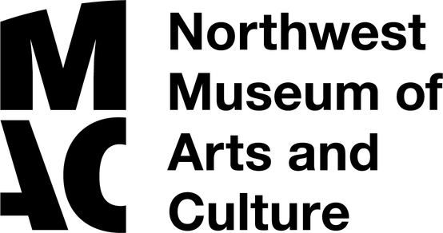
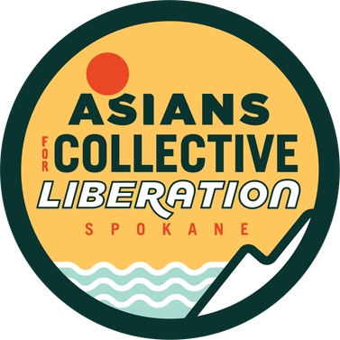



THE
AH YEN FAMILY
Early Spokane Pioneers:
1872-1920
MAC Packs are Sponsored by

Slide 2
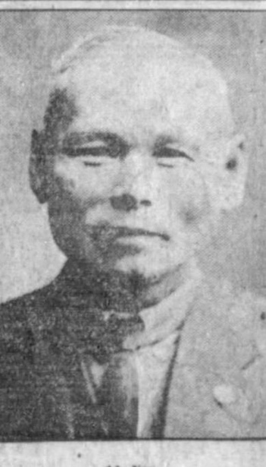
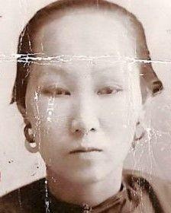
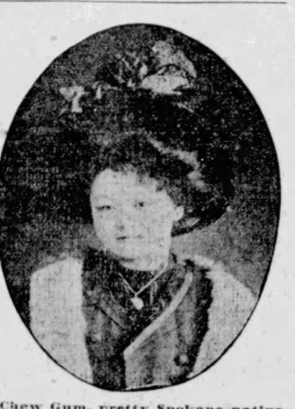
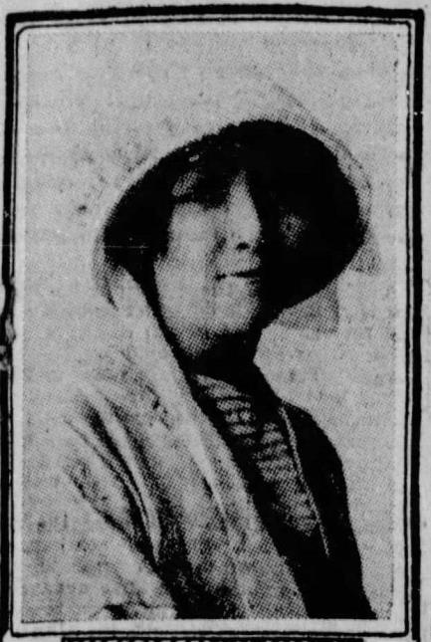
MEET THE
AH YEN FAMILY
Sue
Ah Yen
b.1853
China
Tom Que
Ah Yen
b.1865
Placer County, CA
Chew Gum (Nina)
Ah Yen
b. 1893
Spokane, WA
Meho (Ruby)
Ah Yen
b. 1895
Spokane WA

Slide 3
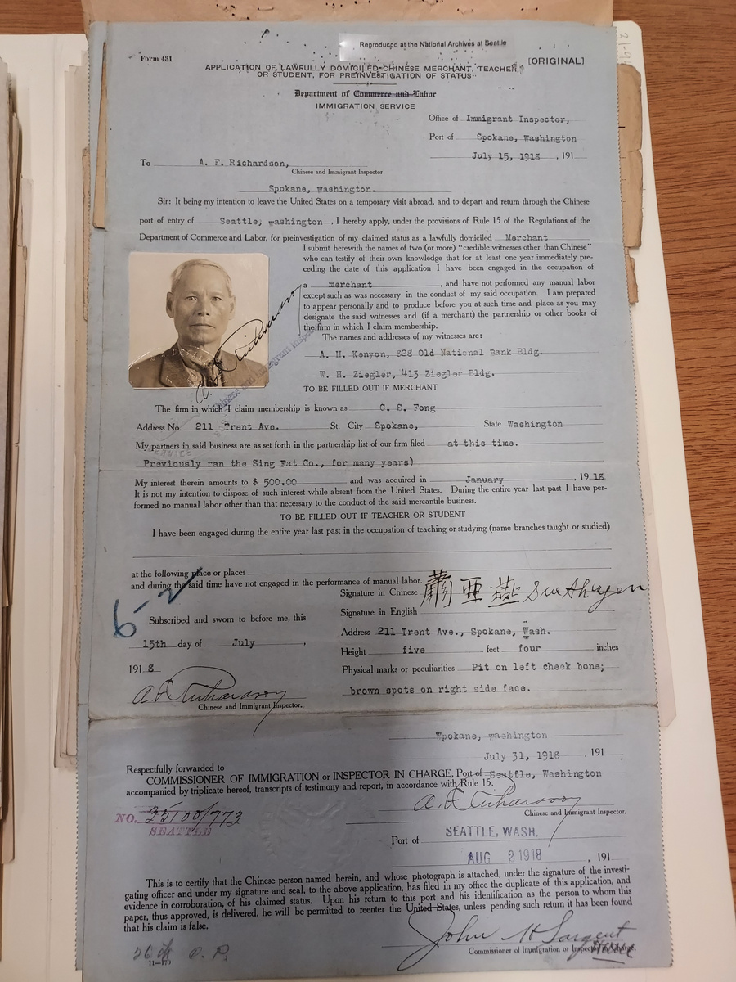
SUE AH YEN
Family History​
Sue Ah Yen, Husband and Father​
Born 11/2/1853 in Canton, China​
​
Immigrated to America from China in September 1872 through the Port of San Francisco.
Moved to Rathdrum, Idaho in 1872 and then Spokane in 1878.​
​
Married Tom Que Ah Yen who was from California. They honeymooned in China and then returned to Spokane, WA.​
​
Opened Import Market on Front Street selling Chinese and Japanese goods, specifically silk.​
​
He was described in the Spokesman-Review in 1902 as “one of the most conspicuous Chinese merchants in Spokane.”​
​
Spokane Pioneer: He participated in a 1904 city-wide parade riding in a carriage with fellow Spokane pioneers James Glover and others.​

Slide 4
TOM QUE AH YEN
Family History:​
Tom Que Ah Yen, Wife and Mother​
Born 1865 in Placer County, California​
​
Citizenship Since Tom Que was born in Placer County, CA, she was an American citizen. She lost her citizenship when she married Sue Ah Yen.
Chinese Exclusion Act of 1882 meant that neither Tom Que nor Sue were eligible to become United States naturalized citizens.​
​
Much of what we know about Tom Que comes from a Spokesman-Review article titled Are the Women of China Happier Than Their American Cousins? written on October 7, 1905, in the Spokane Chronicle.​
​
Settled in Spokane after her marriage to Sue Ah Yen and spending three years in China. She had four children.​
​
When asked in the Spokane Chronicle 1905 article if she and other Chinese women were as happy as American women, with her daughter Chew Gum interpreting, she answered, “Yes-and happier”. She commented that the Chinese clothing was more comfortable than what American women wear.

Slide 5
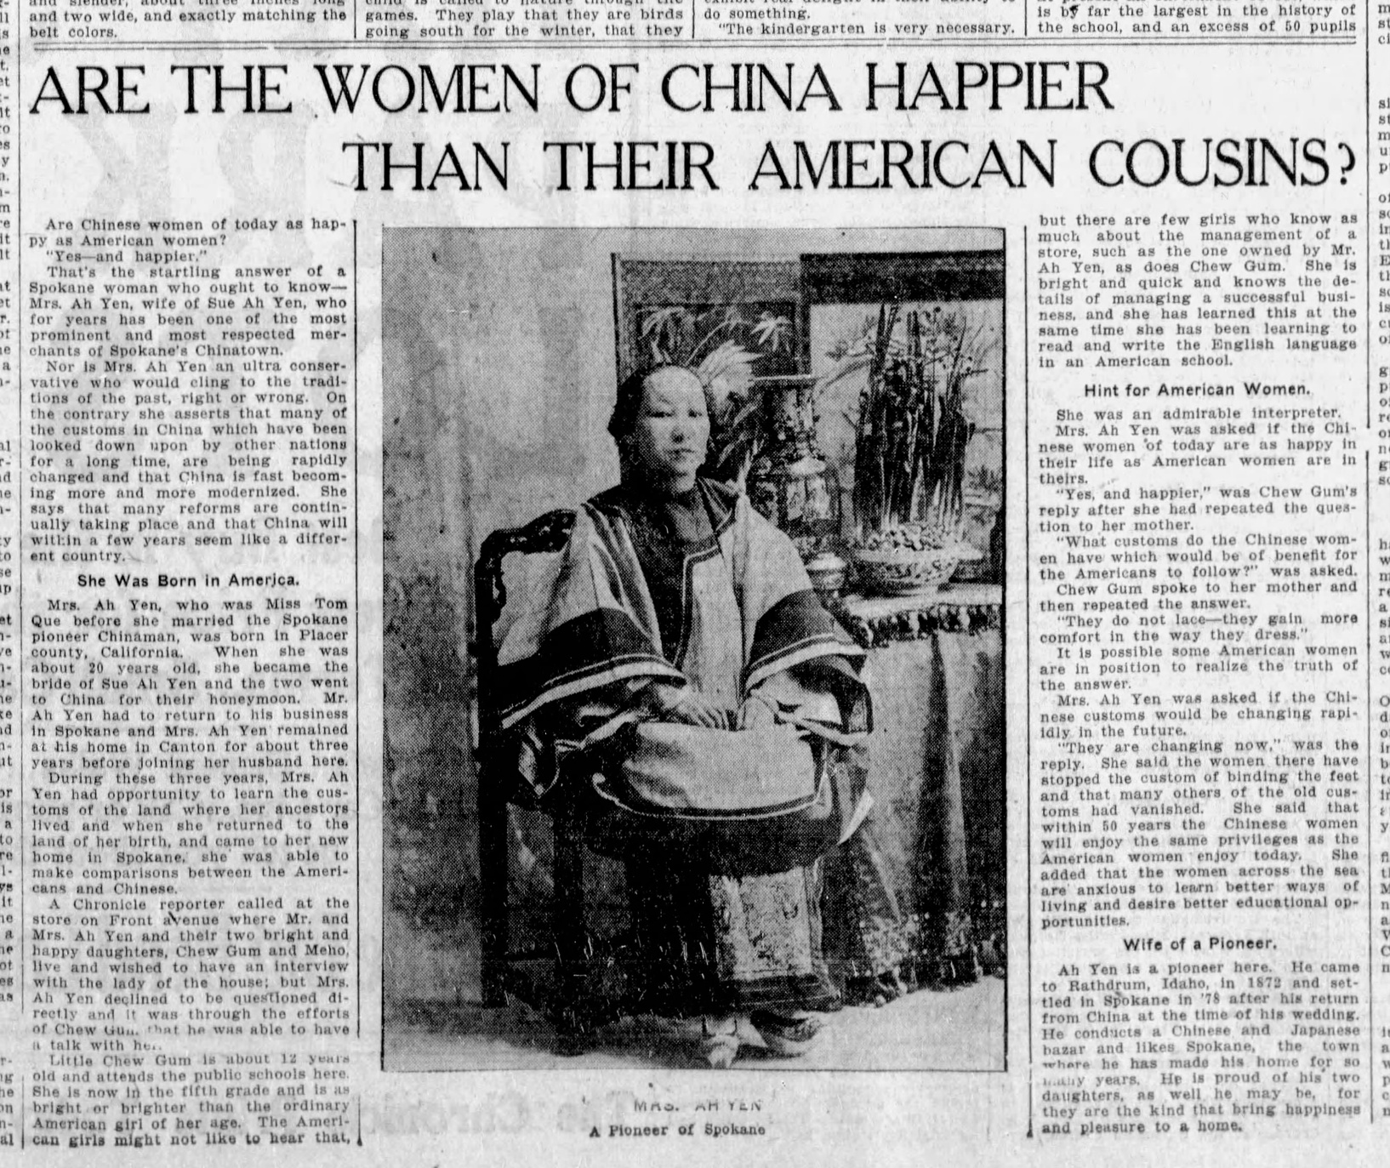
SPOKANE CHRONICLE, OCTOBER 7, 1905

Slide 6
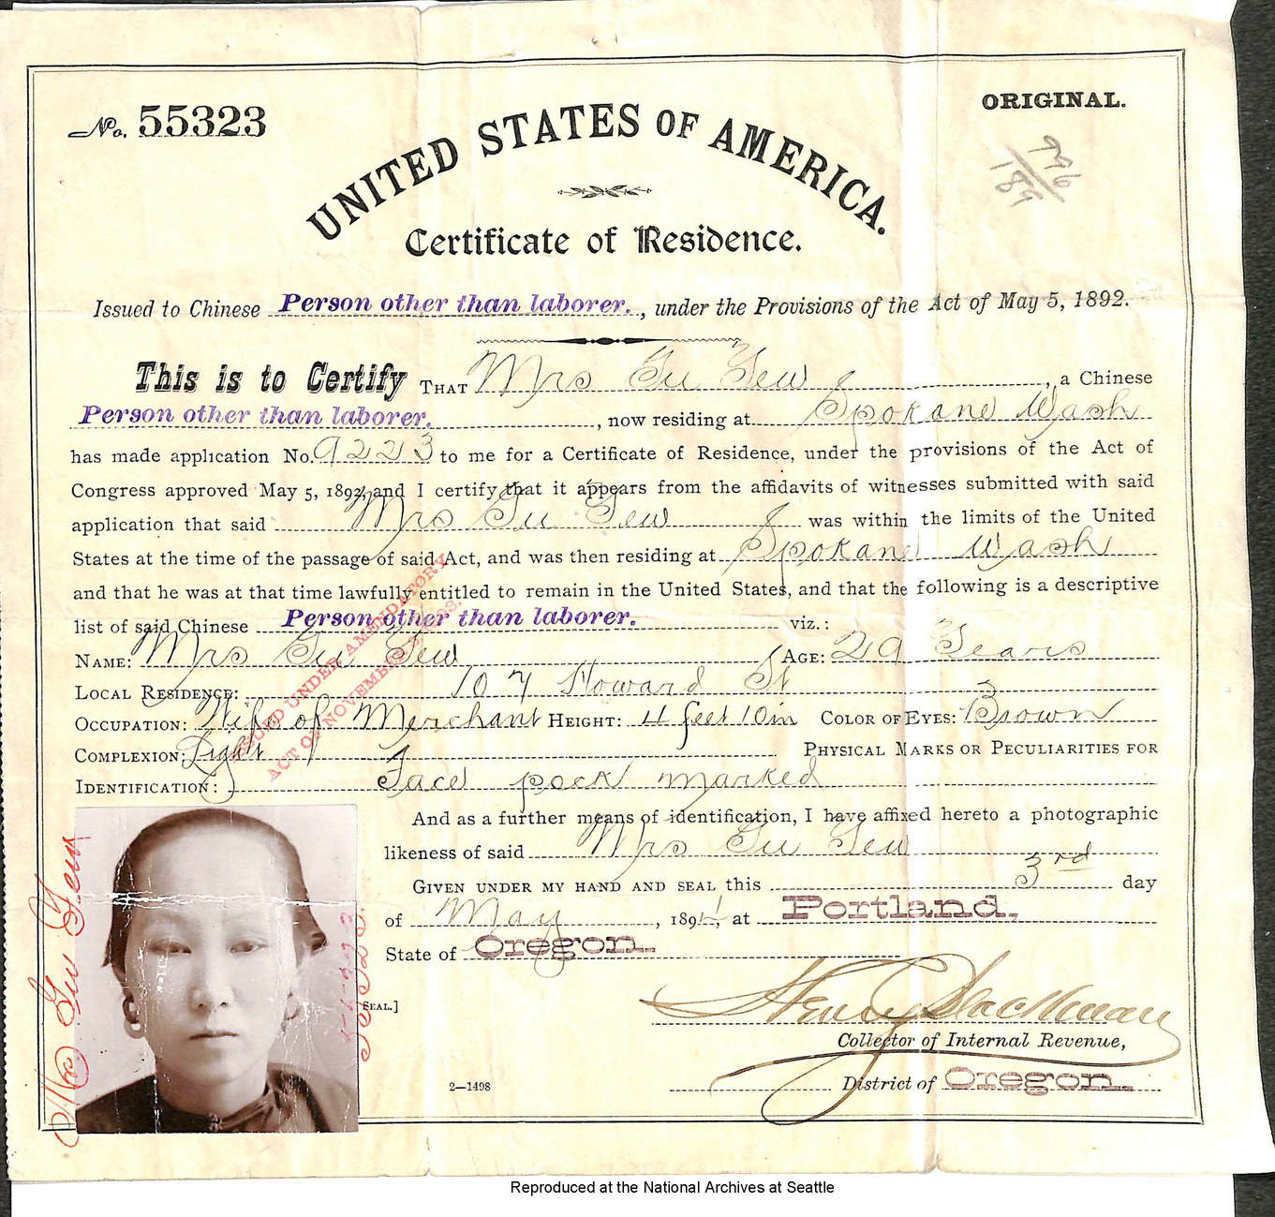
TOM QUE AH YEN
CERTIFICATE OF RESIDENCE

Slide 7
THREE DAUGHTERS AND ONE SON
Gum Sing (Lena) Ah Yen born in Rathdrum, ID in 1883
Hong Loi Ah Yen born in Spokane, WA 1891
Chew Gum (Nina) Ah Yen born in Spokane, WA 1893
Meho (Ruby) Ah Yen born in Spokane, WA 1895
  Went to public school.
  Fluent Chinese and English speakers. They often translated for their parents.
  Featured in Spokane newspapers, both positively, but also in deragatory, un-kind terms.
Why do you think they had both a Chinese name and an American name?
Chew Gum (Nina)
Meho (Ruby)

Slide 8
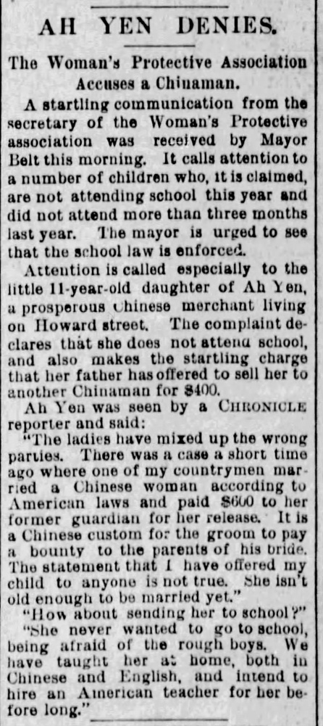
CHALLENGES FACED BY THE FAMILY
  Ah Yen and other Asian immigrants could not legally own property.
  International travel was arduous because of the application process that arose from the 1882 Chinese Exclusion act. Sue and Tom Que had to apply for permission to leave or re-enter the United States, which involved interviews and attestations.
  The family members were seen as a curiosity within the community. Chinese customs were misunderstood. Ah Yen had to clarify and explain Chinese customs.
  Derogatory, un-kind, and prejudiced language was often used to describe the family and other Asian residents in the Spokane newspapers.
  They were targeted for criminal acts such as allegations that their daughter did not show up to school. There were accusations that they were planning on selling their daughter.
Spokane Chronicle
Saturday, October 6, 1894

Slide 9
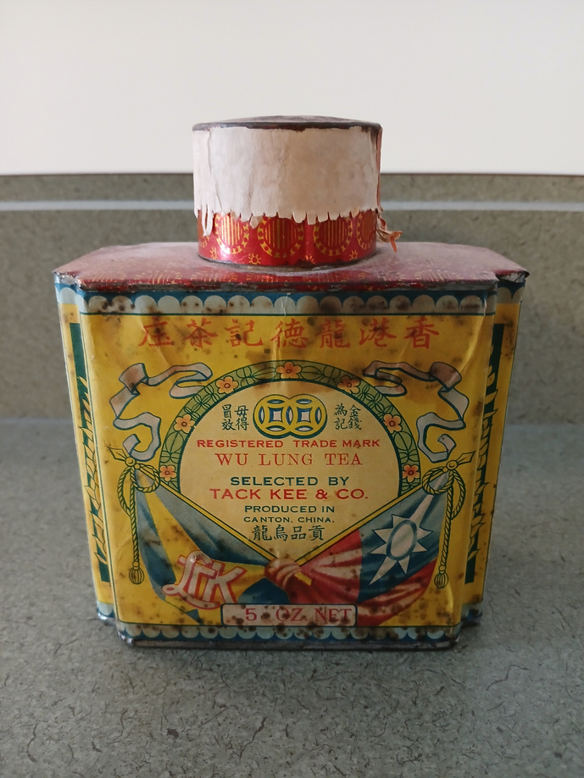
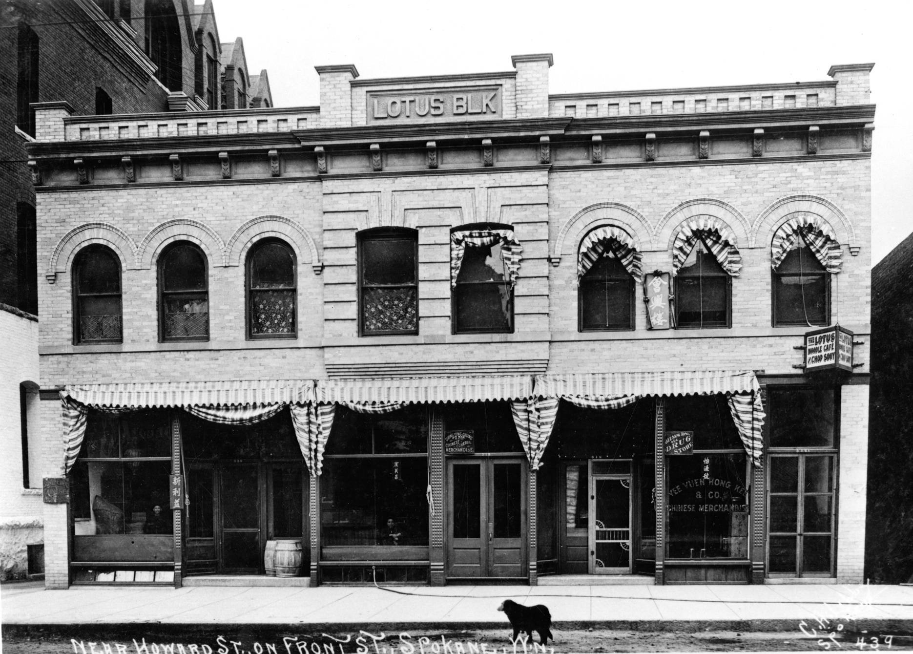
AH YEN FAMILY SUCCESSES
  Sue Ah Yen was a successful businessman. His oldest daughter took over the business.
  Ah Yen appeared to have friends and acquaintances in law enforcement, finance, and the legal profession. Those community leaders saw Sue Ah Yen as a leader in the Asian community of Spokane and would consult with him when they wanted to understand or know more about his community’s perspectives. Ah Yen often had to inform these city leaders about Chinese customs.
  The opportunities that the Ah Yen family did have were rooted within social realms in which Chinese Americans were allowed to operate such as imports and exports. Unfortunately, many other Asian community members, such as common laborers were not given these same respect or opportunities as businessmen such as Ah Yen.
Tea Tin c1890 imported from China.
Joel E. Ferris Research Archives, Lotus Block on Front Street and Howard, 1908, L87-1.439, Ah Yen’s Market was also located on Front Street in Spokane

Slide 10
HOW DO MUSEUMS AND HISTORIANS KNOW WHAT WE KNOW?
Primary Sources: Photos, Documents, Oral Histories, Diaries, and Objects
Secondary Sources: Books and Articles
Take a look at these objects, photos, and documents from over 100 years ago. What can we learn from them?

Slide 11
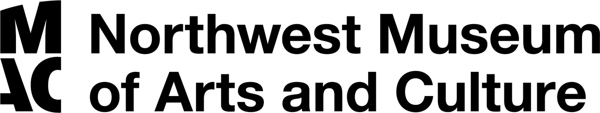
THANK YOU
MAC Packs are Sponsored by

Slide 12
HISTORIANS STUDY OBJECTS, THE MATERIAL CULTURE THAT PEOPLE FROM THE PAST LEFT BEHIND, IN ORDER TO UNDERSTAND HISTORY. OBJECTS ARE THE PRODUCTS OF HUMAN WORKMANSHIP - OF HUMAN THOUGHT AND EFFORT - OBJECTS TELL SOMETHING ABOUT THE PEOPLE WHO DESIGNED, MADE, AND USED THEM.
WHAT QUESTIONS DO HISTORIANS ASK THEMSELVES WHEN THEY ANALYZE OBJECTS?
  First impressions: What are your first impressions of this object? Do you have any ideas what the object might have been used for?
  A closer look at the physical features: What is it made of? Why was this material chosen? What is the texture and color? What does it smell like? Can it be held? Is it heavy or light? Is it intact, or does it look like parts are missing? Does it look new or old?
  Construction: Is it handmade or made by machine? Where was it made? Who made it?
  Function: How is this object used? Does it have a practical use or is (was) it used for pleasure? Has it been used? Is it still in use? Has the use changed? Where could it have been found? What value does it hold to you and to others?
  Design: Is it designed well? Is it decorated? How is it decorated? Is it aesthetically pleasing? Would it make a good gift? Does it remind you of anything else?
  Who may be connected with the object? What type of person might have used this object? What type of person might have made this object? What does this object tell us about the maker and user?
  Thinking further: Is this type of object still being made today? Is it still in use? If not, why do you think it isn’t used today? Should this object be in a museum collection? Why or why not? What questions do you have about the object that you can’t answer from just looking at it?

Slide 13
PHOTOGRAPHS PROVIDE US WITH IMAGES OF PAST EVENTS. TODAY, HISTORIANS STUDY THE CONTENT AND MEANING OF THESE VISUAL IMAGES TO LOCATE INFORMATION ABOUT A PARTICULAR TOPIC, TIME, OR EVENT. PHOTOGRAPHS CAN CONVEY COUNTLESS DETAILS ABOUT LIFE. FOR HISTORIANS AND FOR US, “A PICTURE IS WORTH A THOUSAND WORDS.”
PHOTOGRAPHErs can manipulate, intentionally or unintentionally, the record of the event. It is the photographer – and the camera’s frame – that defines the picture’s content. Thus, the photographer chooses what will be in the picture, what will be left out, and what the emphasis will be. When analyzing photographs, ask yourself the following questions:
  Take a closer look: Make sure to examine the whole photograph. Make a list of any people in the photograph. What is happening?
  Looking more closely: Are there any captions? A date? Location? Names of people? What kind of clothing is worn? Are there any words on signs or buildings?
  Thinking Further: If people are in the photograph, what do you think is their relationship to one another? Can you speculate on a relationship between the people pictured and someone who is not in the picture?
  What do you think happened before and after the photo was taken? Who do you think took the photo and why?
  What does this photograph suggest to you? What questions do you have about the photo? How could you try to answer them?
  What is the one thing that you would remember most about this photograph and why?
  What questions do you have about the photograph that you cannot answer through analyzing it? Where could you go next to answer these questions?

